Slide 1
WorkshopPLUS - Windows Server: Vital Signs Part 1
Notes:
Version: 12/21/2018 18:22:55

Slide 2
Disclaimer

Slide 3
Introduction to Performance Monitor

Slide 4
Performance Monitor

Slide 5
Learnings covered in this Unit
Start and add-remove Counter
Manipulations with counters
Counter views

Slide 6
Start and add-remove Counter

Slide 7
Introduction to Performance Monitor
Microsoft Performance Monitor (Perfmon) is a simple yet a powerful visualization tool for viewing performance data, both in real time and in log files
You can examine performance data in a graph, histogram, or report view
Built in to computers based on Windows NT

Slide 8
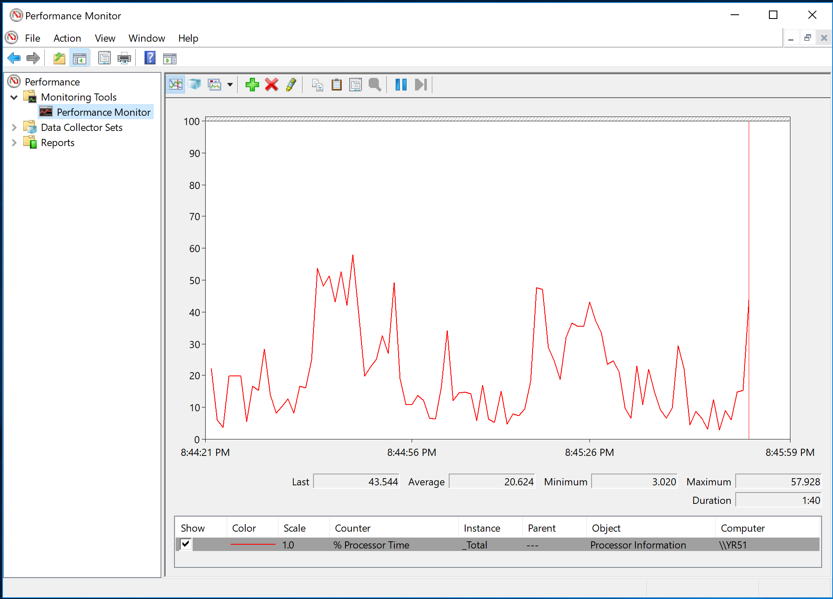
Start Performance Monitor
Click Start.
Type Perfmon in the Search box.
Click Perfmon.exe
Notes:
To start the Performance Monitor (Perfmon):
Click Start.
In the Search box, type perfmon, and then click the Perfmon executable.
In Windows 8, navigate to the Start screen and type perfmon.

Slide 9
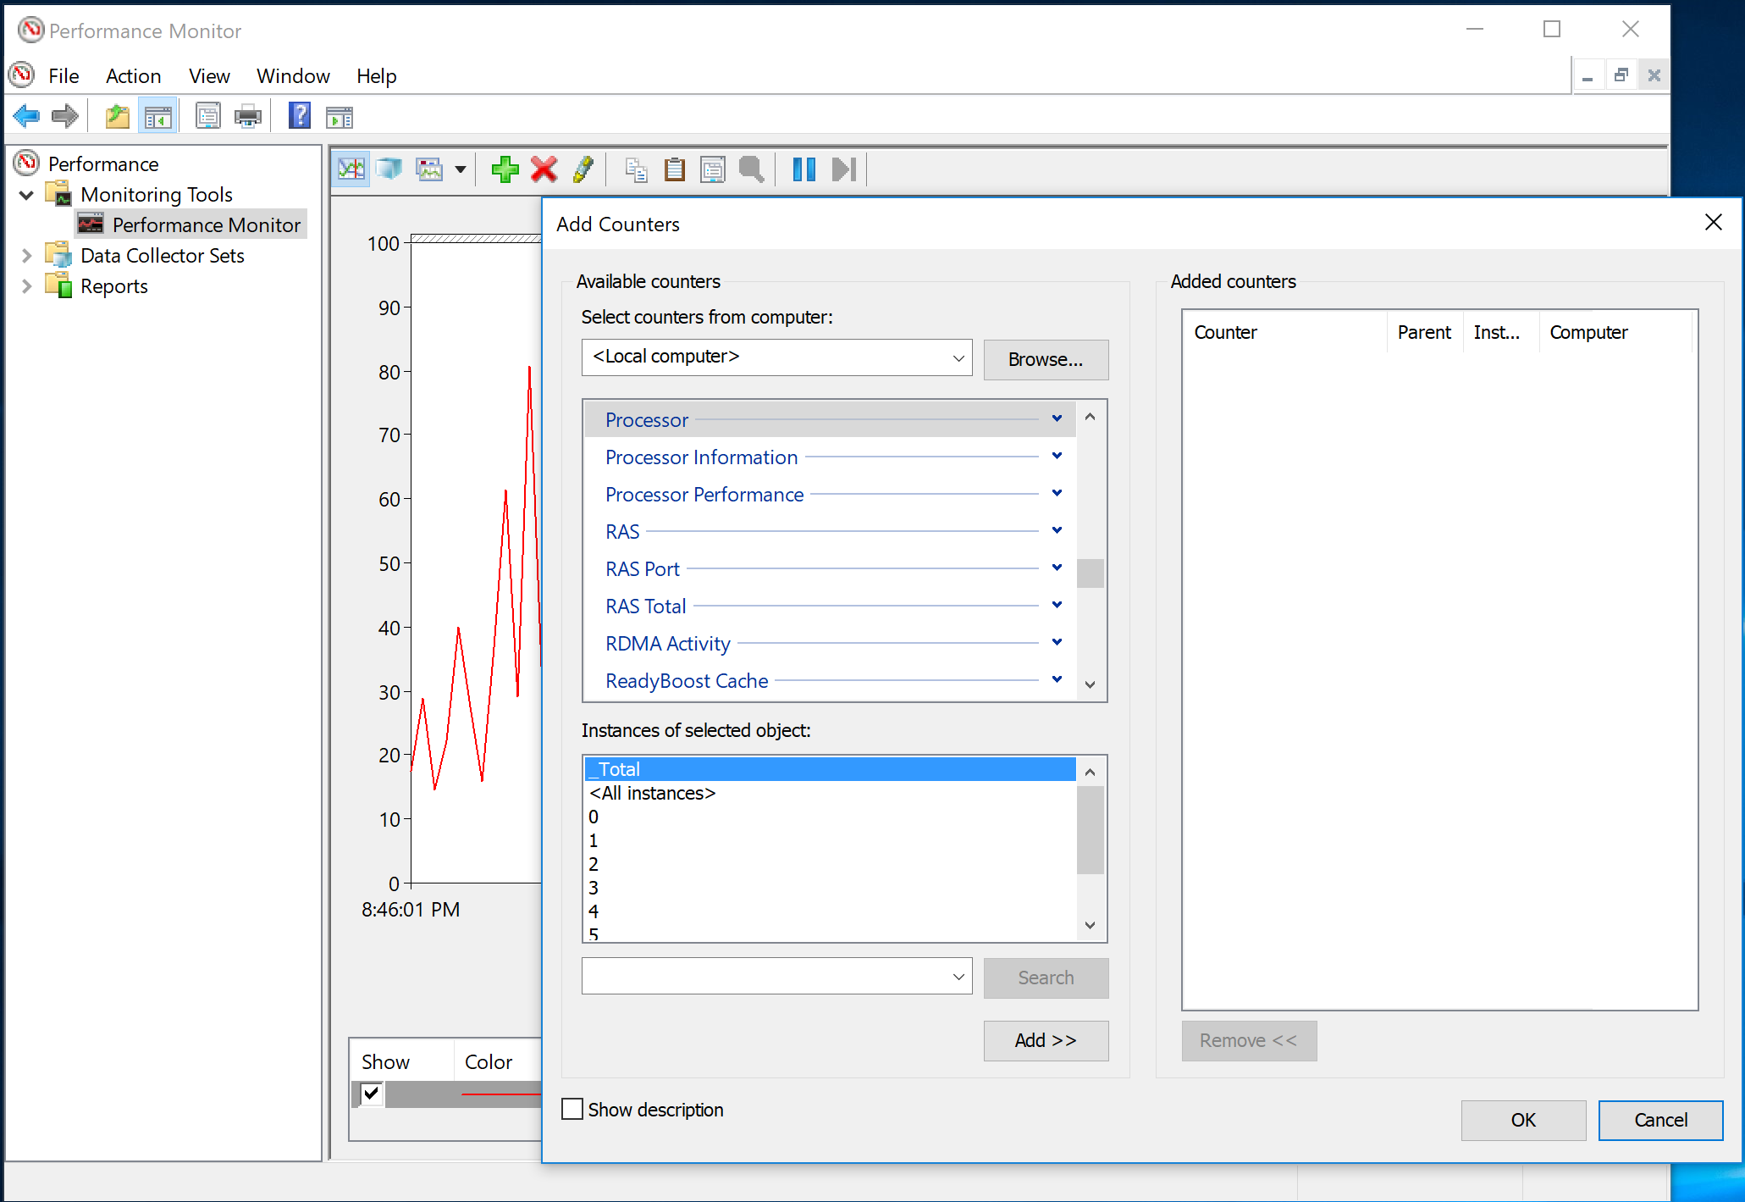
Add Counters
To browse the counters to Perfmon, click
Notes:
To add counters to Perfmon, click the green plus sign at the top of the window. The Browse Counters dialog box opens, which shows all of the counters available from a given data source, such as:
Local counters
Counters from remote computers
Counters from counter logs

Slide 10
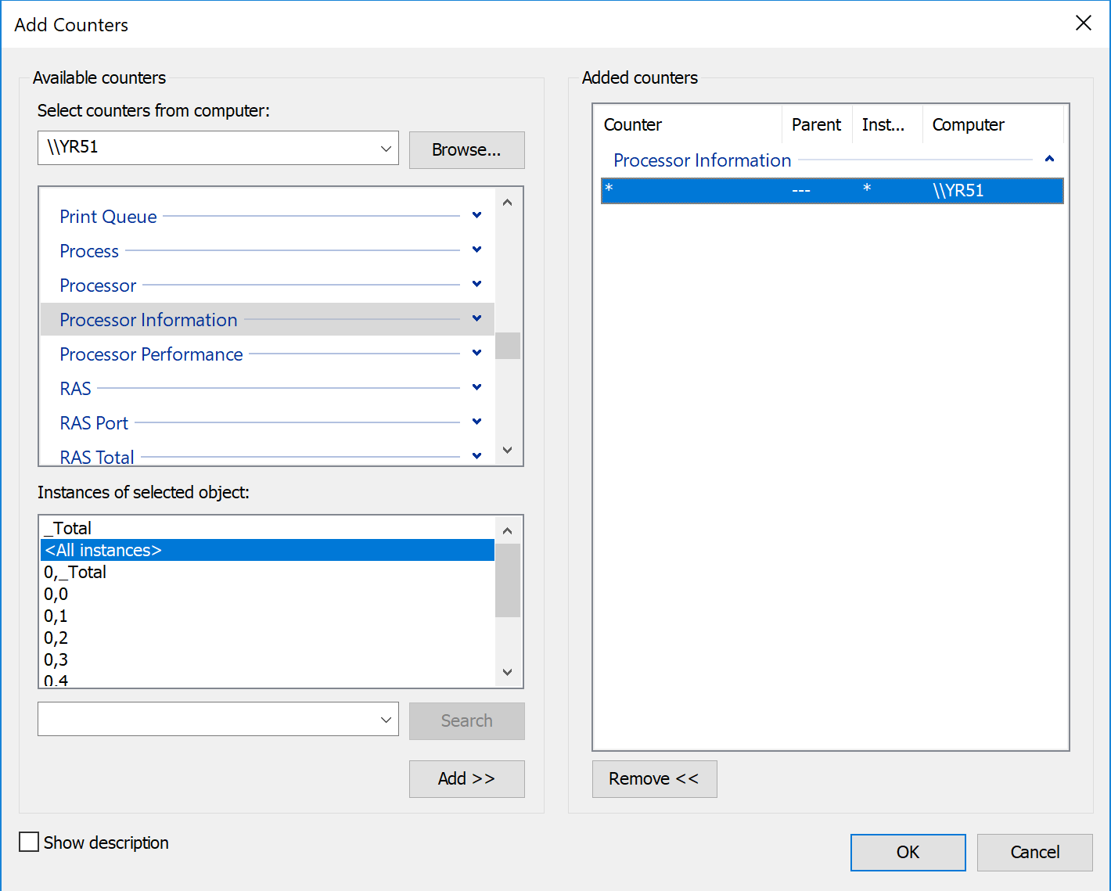
Add Counters
In Select counters from computer, type or browse to the computer name, expand the counter type, select each counter, and then click Add. When you are finished, click OK
Notes:
When adding counters, ensure to click Add so that the counter path appears in the right pane and click OK.
The Browse Counters dialog box shows the counter objects (also known as counter categories). You can expand the counter objects to show the counters in that object.
After you select the counter object or one of the counters in the counter object, the counter instances appear in the pane below. If you click <All Instances>, you add all of the counter instances of the counter object. Otherwise, you add only the specific counter instances.

Slide 11
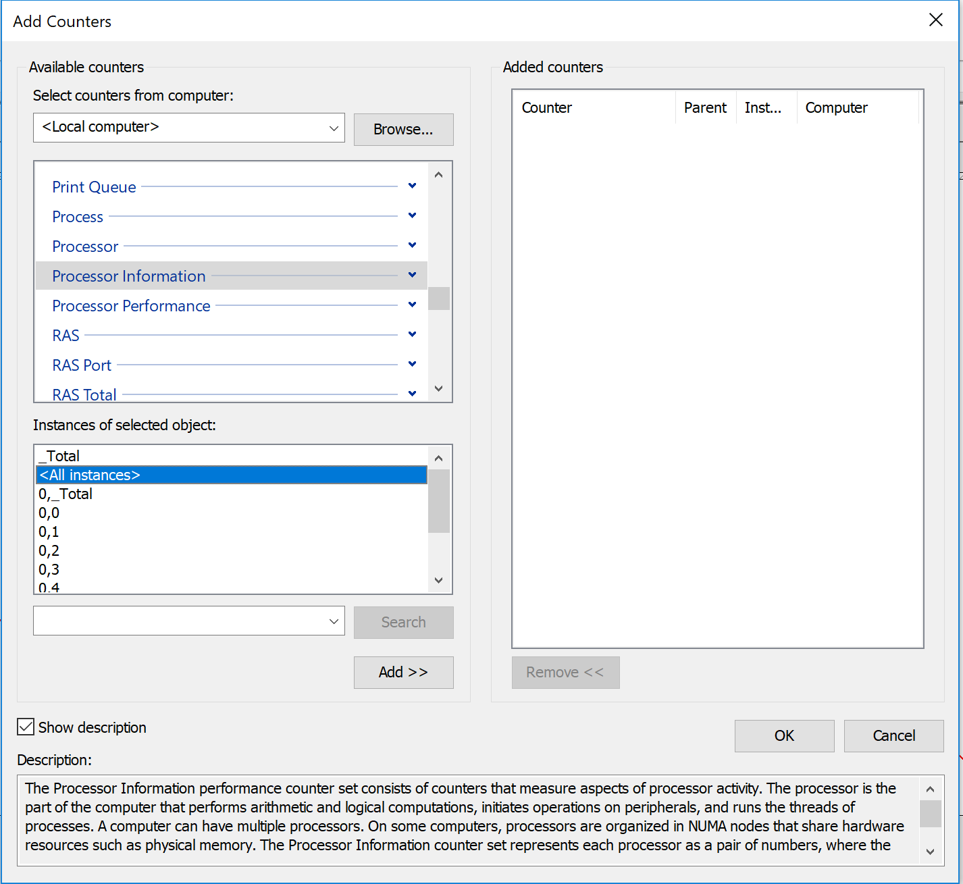
Show a Counter Description
To learn more about a counter, show the counter description
Click the Add Counters button .
Select a counter, and then select Show Description
Notes:
You can see the counter description only on the local computer, and only when you are looking at the live performance counters. This means that if you have a counter log open, it does not show the counter description.
Counter descriptions explain what the counter is measuring. The Microsoft TechNet and Microsoft Developer Network (MSDN) Websites typically have additional information about the performance counters.

Slide 12
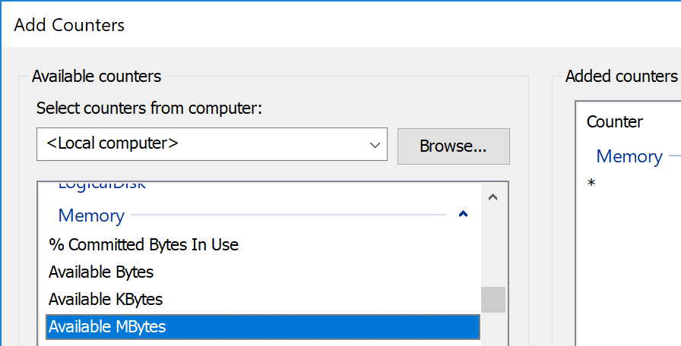
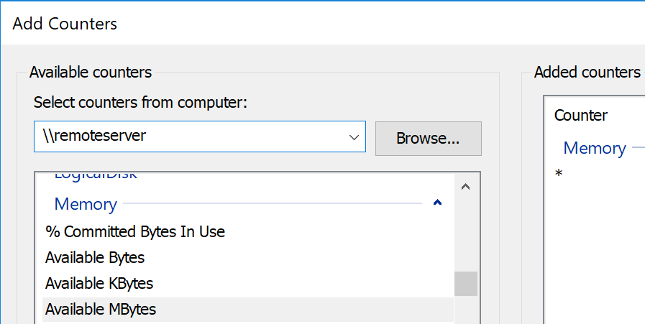
Reading the Counter Path
Syntax Example:
\\LocalComputer\Object(Instance)\Counter
\\RemoteServerName\Processor(_Total)\% Processor Time
Notes:
The counter path is a definition of one or more counter instances. It is similar to a UNC network share, but it has a slightly different syntax. The path can optionally include a computer name, which is used to connect to the named computer—this can be the local computer or a remote computer. If the Computer portion of the path is omitted (example: \Processor(_Total)\% Processor Time), the local computer is assumed. You can use the asterisk (*) as a wild card for counter instances (example: \Processor(*)\% Processor Time), counter names (example: \Processor(_Total)\*), or both (example: \Processor(*)\*).
Computer
The computer where the counter exists
If no computer is specified, use the local computer
Object
The logical grouping of counters (Example: Processor, Memory)
Counter
The name of the counter (Example: % Processor Time)
Instance
A specific instance of a counter on the computer (Example: _Total)

Slide 13
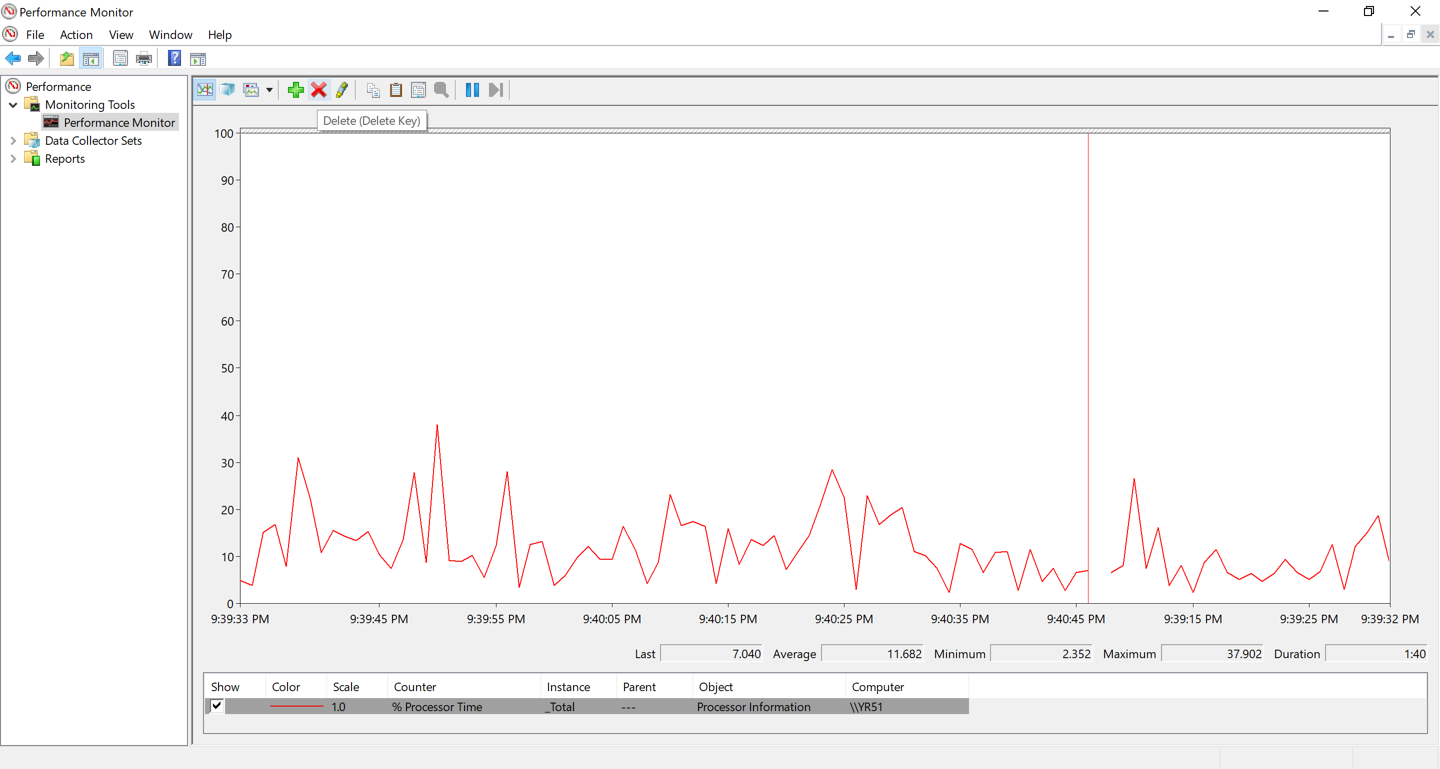
Remove Counters
To remove counters, select them, and then either click or press Delete.
Notes:
To remove the counters, select the counter instances, and then
either click X on the toolbar
or
press the Delete key.

Slide 15
Manipulations with counters

Slide 16
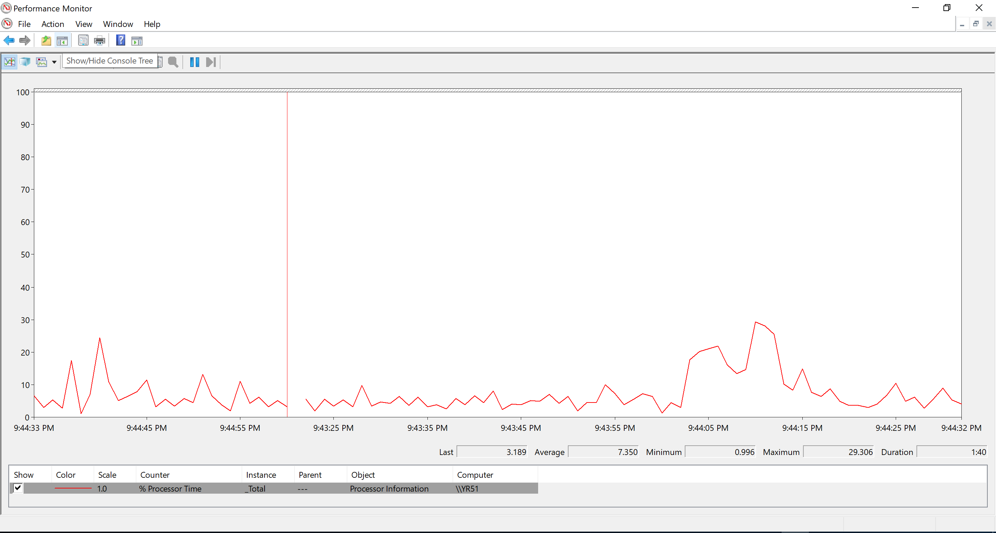
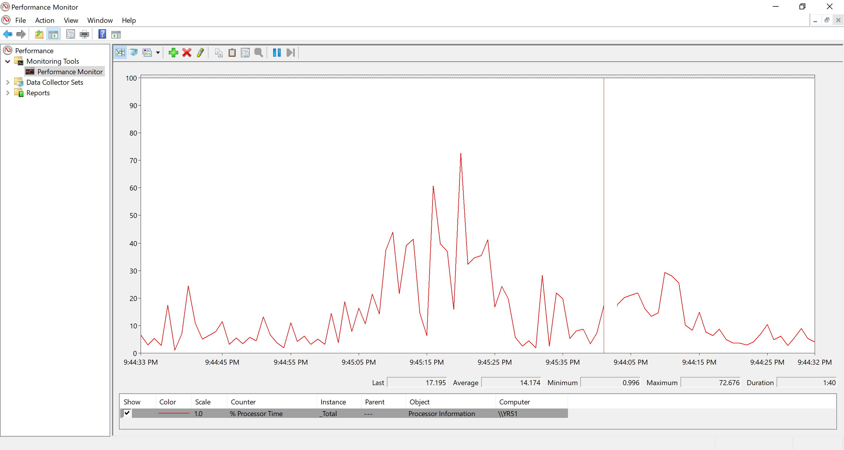
Show or Hide the Console Tree
To show or hide the console tree, click
Notes:
To show or hide the console tree (on the left), use the button menu. This is helpful when you need the extra screen space.

Slide 17
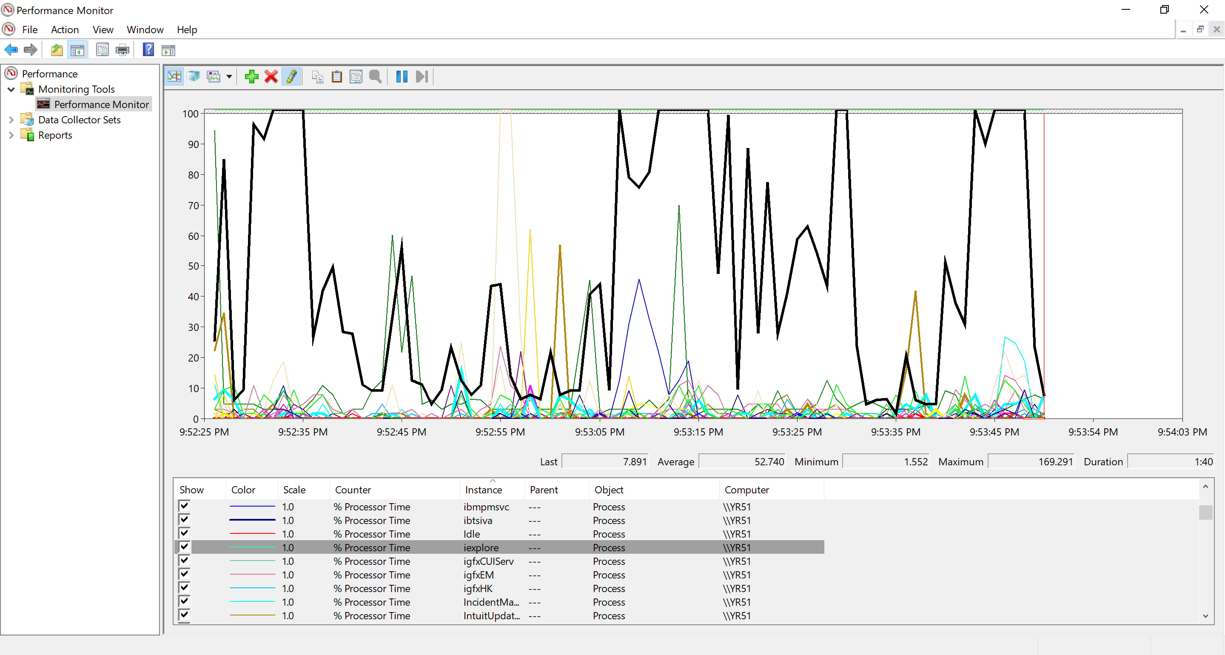
Highlight a Counter
To highlight a specific counter on the graph, select the counter, and then click
Notes:
To highlight the counter lines in the chart of the selected counter instances, either click the highlighter icon at the top of the Perfmon window or press Ctrl + H.
This feature is very helpful when you are looking at a lot of counter instances. The color of the highlighted counter (or counters) contrasts with the background color of the chart.
For example, if the chart background is black, the highlighted counter is white

Slide 18
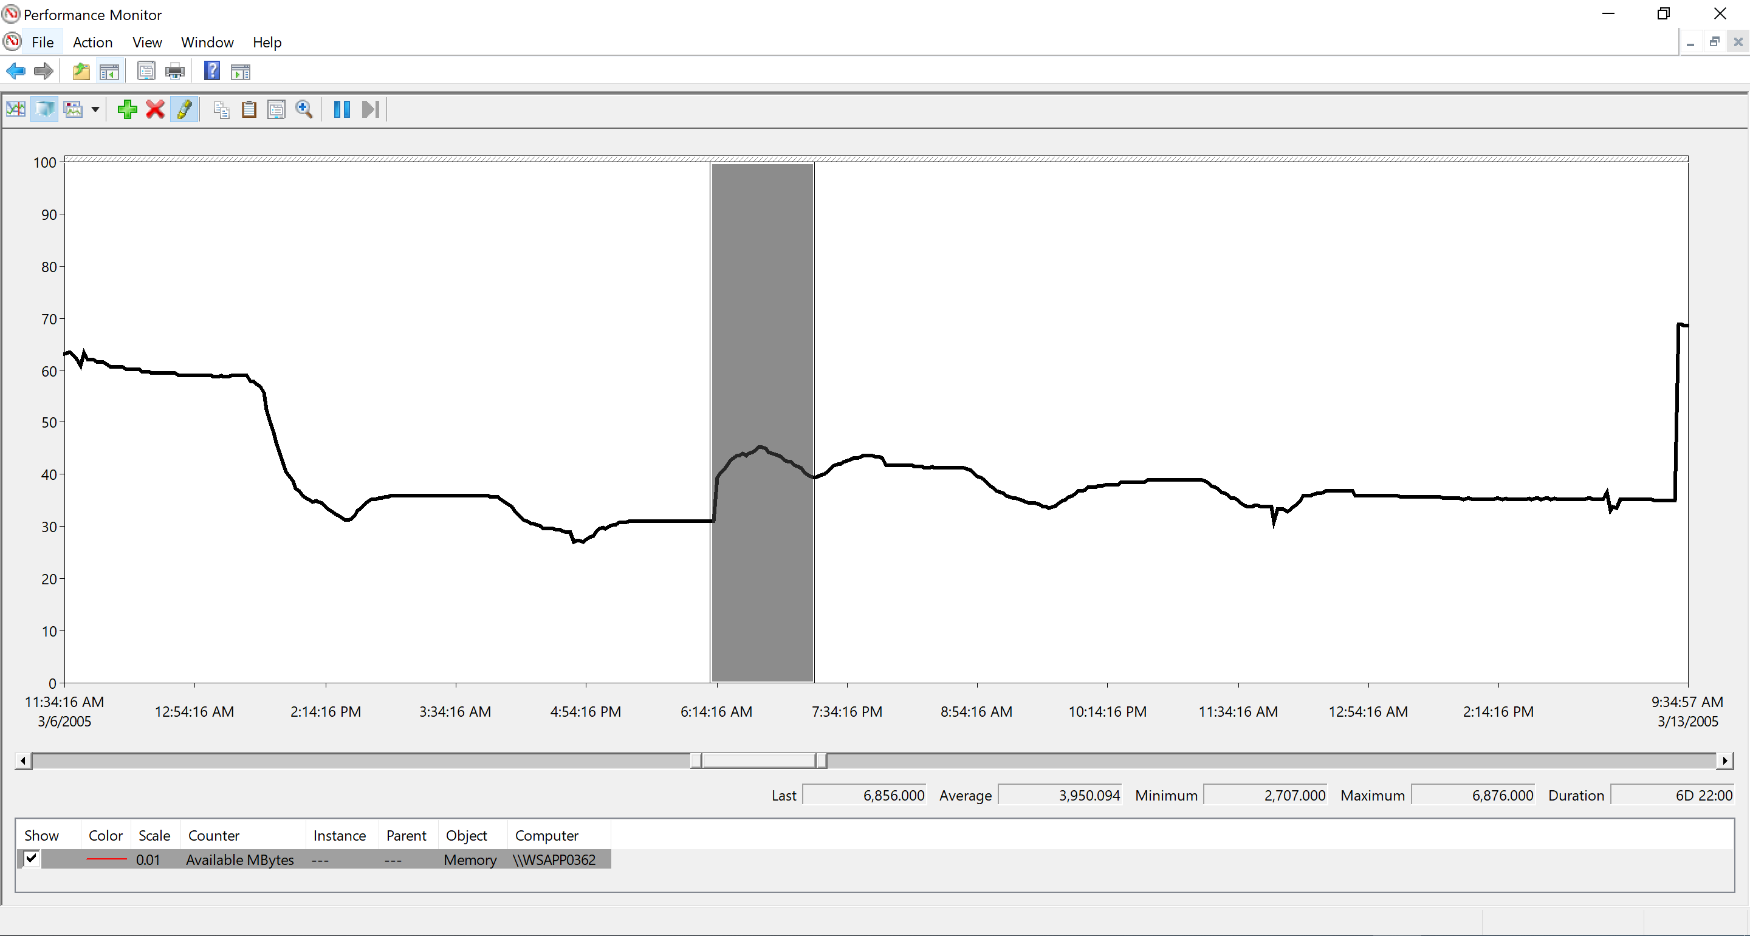
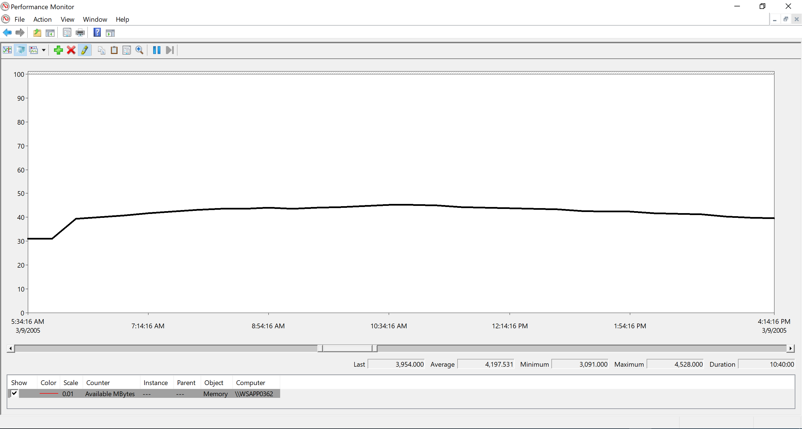
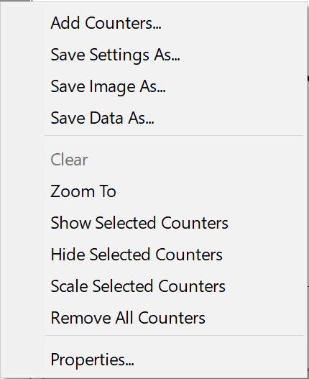

Adjusting the Time Range
If you want a closer view of a particular time range, zoom in on it, by doing one of the following:
Select the time range by using the time-range bar (gray slider), right-click the time-range bar, and then select Zoom To
Open the Properties page for the counter log, click Source, and then change the time range
Before
After
Time range bar
Notes:
When you have a counter log loaded into Perfmon, remember that there might be more data in the log than what the chart can show. In Windows Server 2008 and later, the Perfmon chart can show up to 1000 data points.
In the example on this slide, the counter log has more than 1000 data points, so you can zoom in to the specific time ranges to see more details.
The Perfmon chart on Windows XP, Windows Server 2003, and earlier can show up to 500 data points.

Slide 19
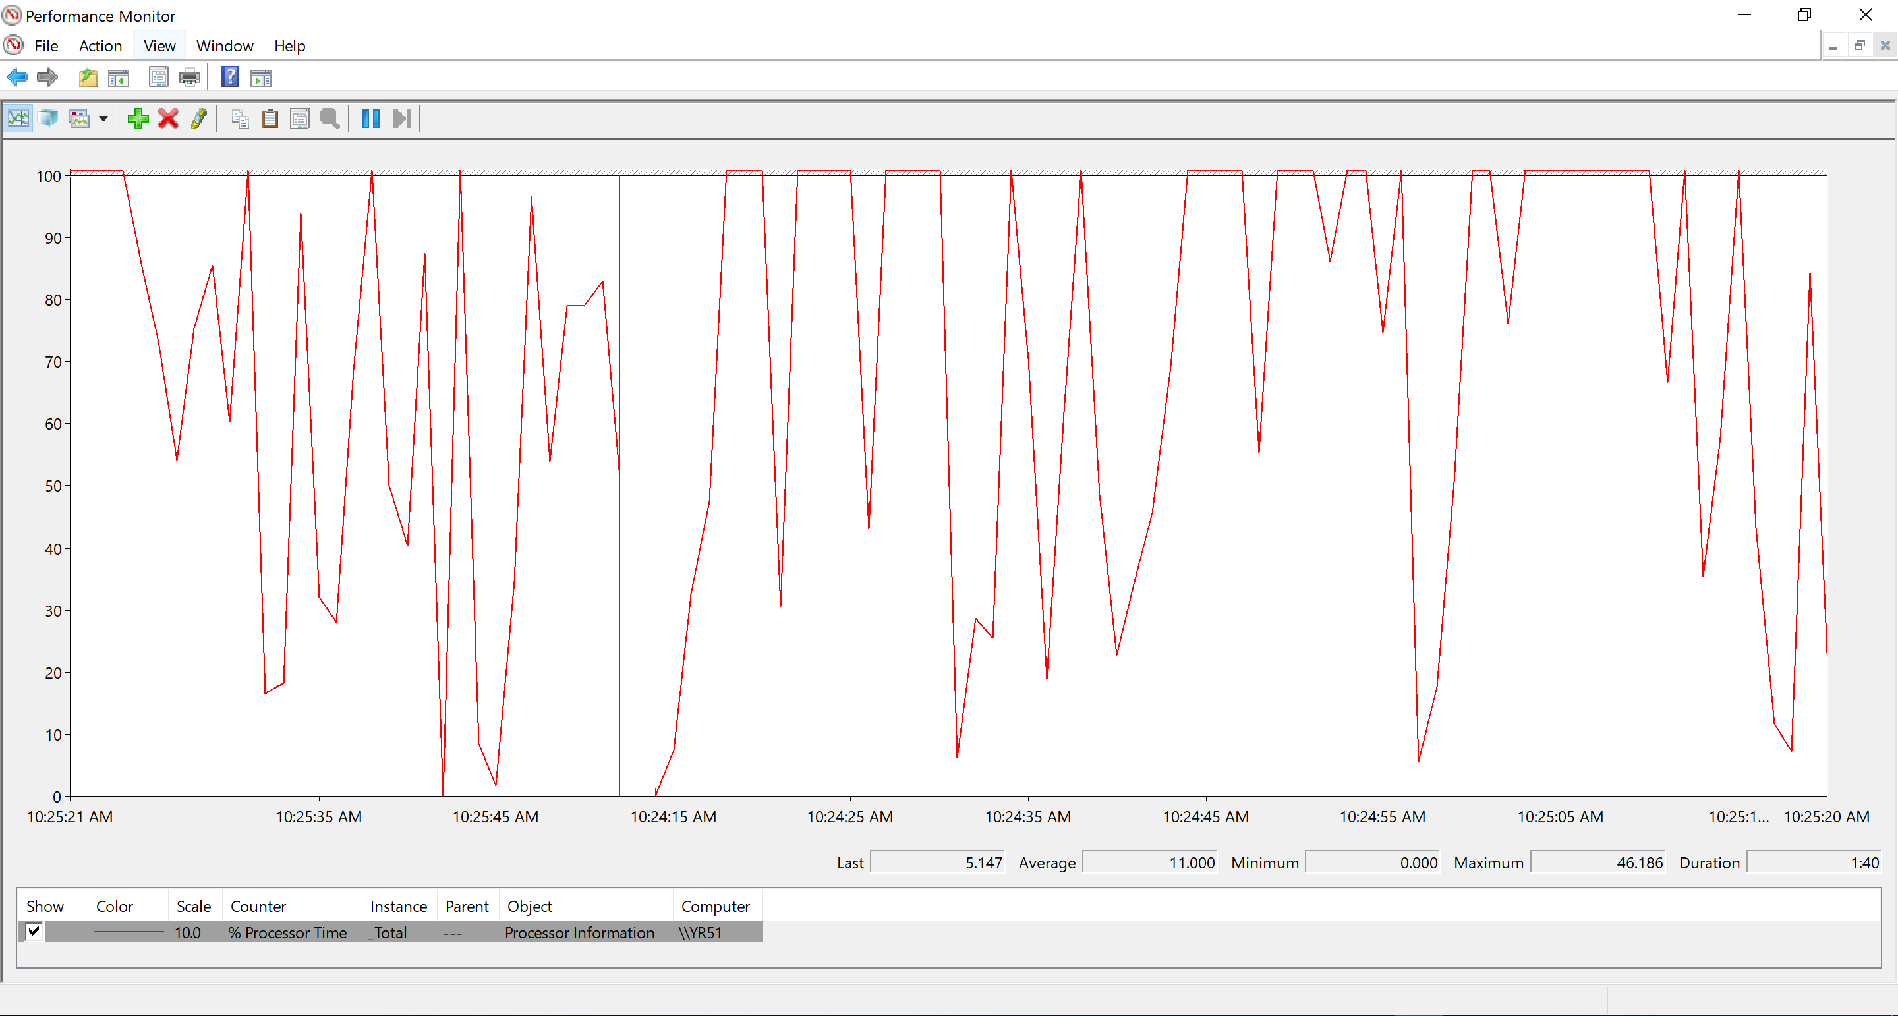
The Last, Min, Avg, and Max values in the Graph
These values are not affected if you change the scale of the graph
Notes:
The Last, Minimum, Maximum, and Average fields show the respective values for the counter instance that is selected. If more than one counter instance is selected, the last selected counter is used. The values are based on the data points that are in the current view of the chart.

Slide 20
Change the Scale Multiplier of the Graph
The scale multiplier, controls the amplitude of the counter in the chart and not the values of the counter
Each counter can have a different scale multiplier
5.147 x 10.0 = 51.47
Notes:
The scale of a counter controls the amplitude of the counter in the chart, i.e., if the scale is 10, the counter value is multiplied by 10 and plotted on the chart. In the example on the slide, the counter value of 8.465 is multiplied by the scale value of 10 and then plotted on the chart at 84.65. The values in the number fields (Minimum, Average, Maximum, and Last) are not multiplied by the scale.
Note: It is possible to scale a value greater than the maximum vertical values on the chart.
In the example, if your value was 78.28 multiplied by a scale value of 10 and then plotted on the chart 782.8, and since the chart only allows us to plot a value of 100 (the maximum vertical value), 782.8 will be graphed as 100. It is also true if we try to plot a value of less than 1, it will be plotted as zero.
When you analyze the counter data, use the values in the number fields first, and then use the line chart to show relative data over time.
For example, an increasing trend, over a few days, might appear as a clear memory leak, until you look at the number fields and realize that it was only a 1 MB leak. It is necessary to always look at the number fields first, because they are not modified by the scale multiplier.

Slide 21
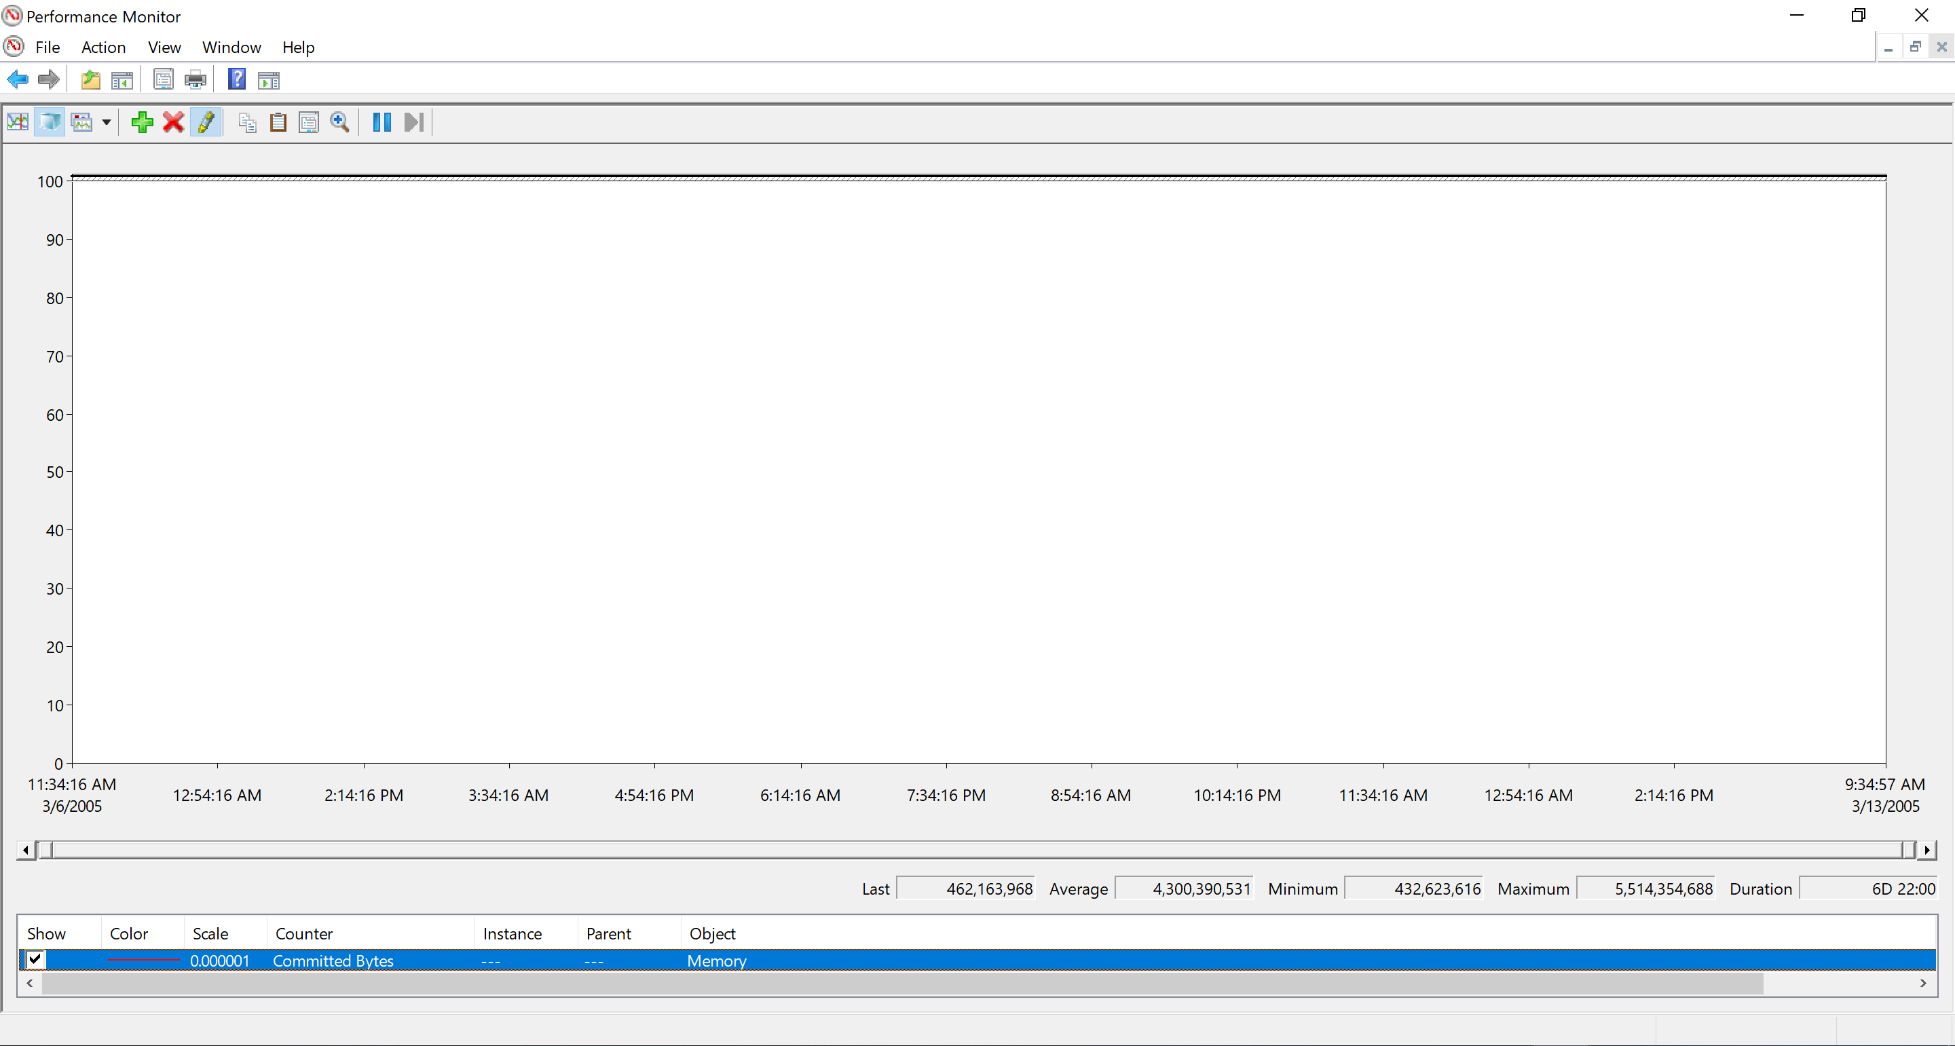
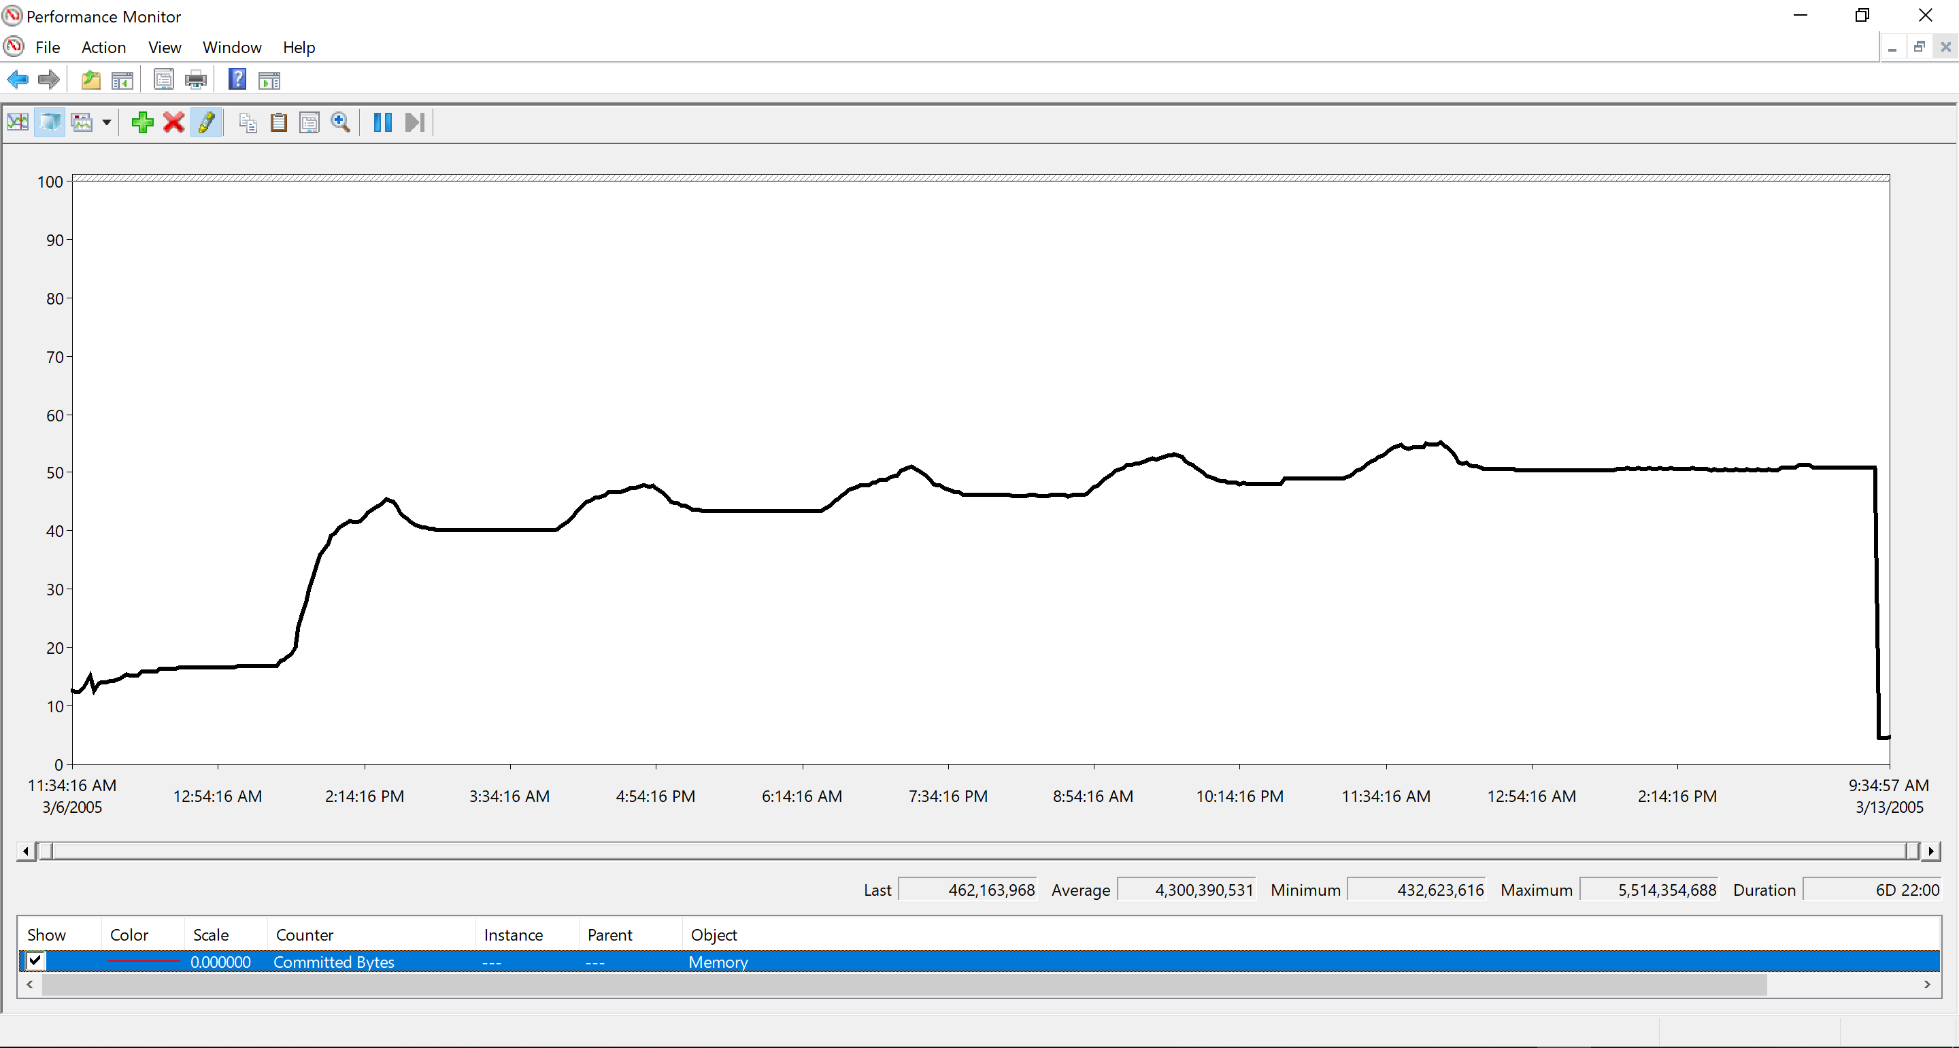
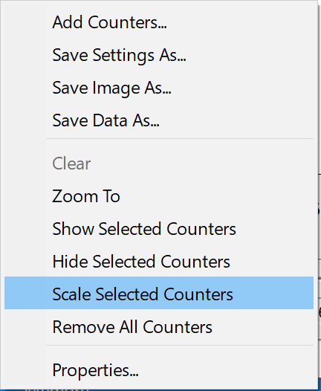
Automatically Set the Scale Multiplier
You can automatically scale counters to fit between the minimum and maximum values of the chart
Select the counters, right-click them, and then select Scale Selected Counters
Notes:
Windows Server 2008 and later includes a new version of Performance Monitor (Perfmon). One of its features is to scale selected counters. This means that Perfmon determines the best scale multiplier that fits most of the counter data within the chart’s current minimum and maximum range. This feature is helpful when you are looking either at counters that measure different resources or at counters of different units (megabytes, kilobytes, and bytes).

Slide 22
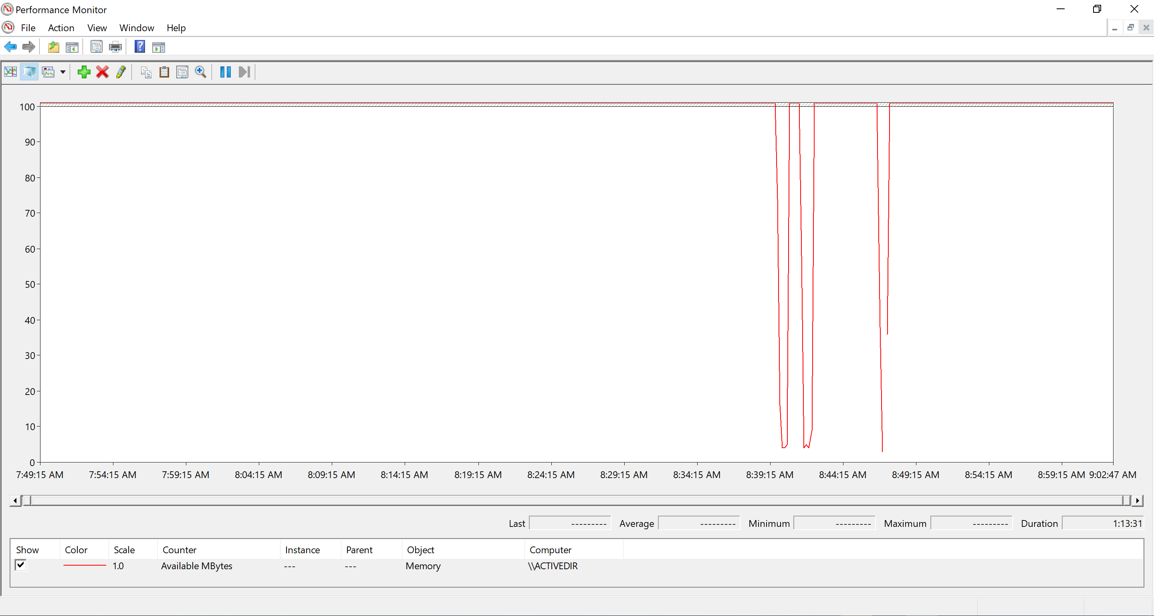
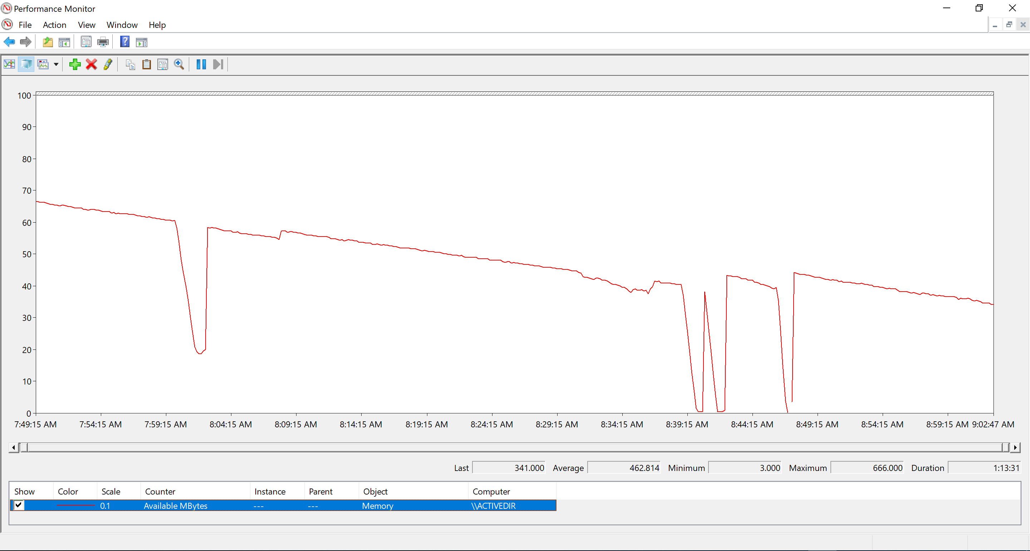
Automatically Set the Scale Multiplier
If you automatically set the scale multiplier, helpful patterns in the graph are seen, as the activity is brought to the graph center
If the graph line is artificially flattened against the top or bottom of the graph, we will miss the downward trend observed below
Notes:
The counter values that exceed the maximum value of the chart are plotted at the maximum value of the chart. The Scale selected counters feature changes the scale to the optimal setting that fits within the current minimum and maximum range of the chart. The figure on the slide shows that most of the data points of the Available MBytes performance counter are too high to plot on the chart, but a quick auto-scale of the performance counter gives the optimal scale to see counter values relative to each other.

Slide 23

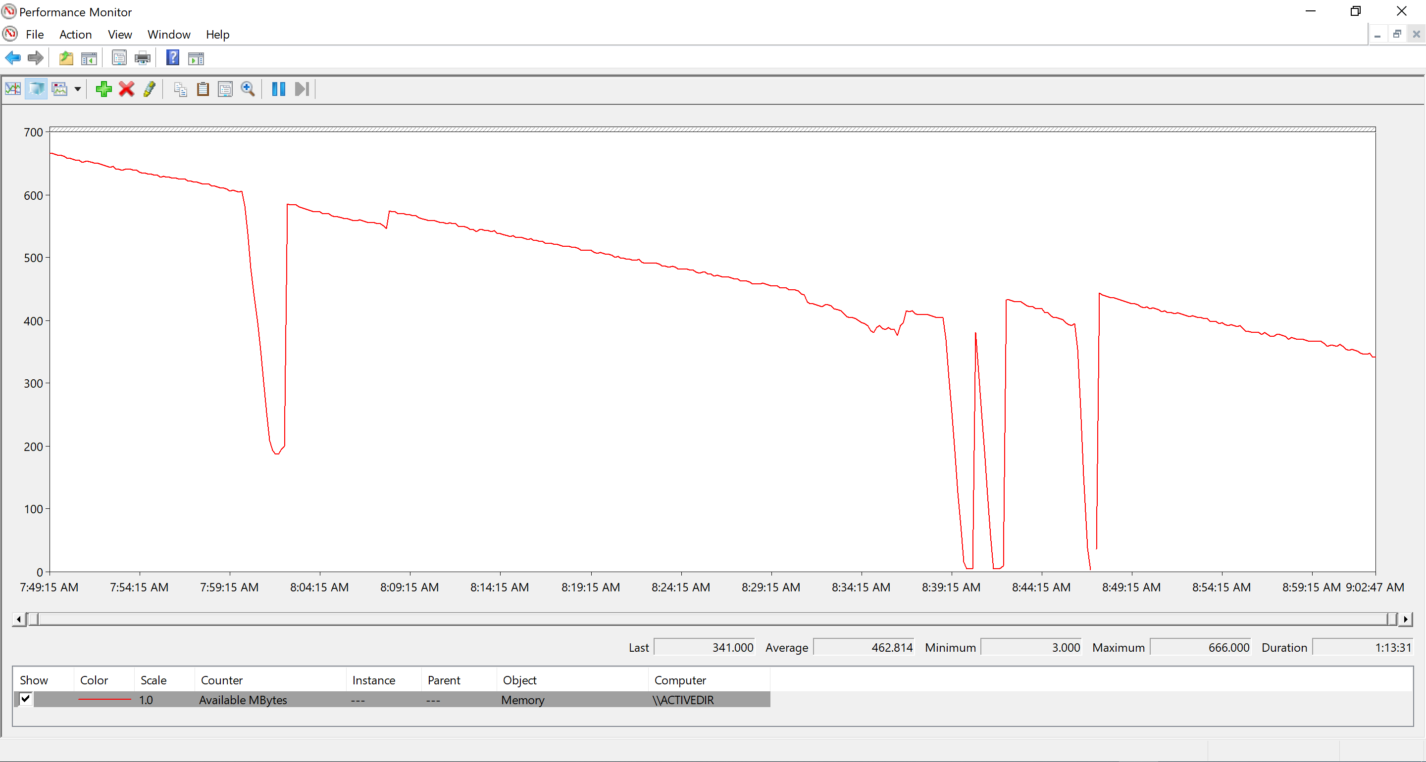
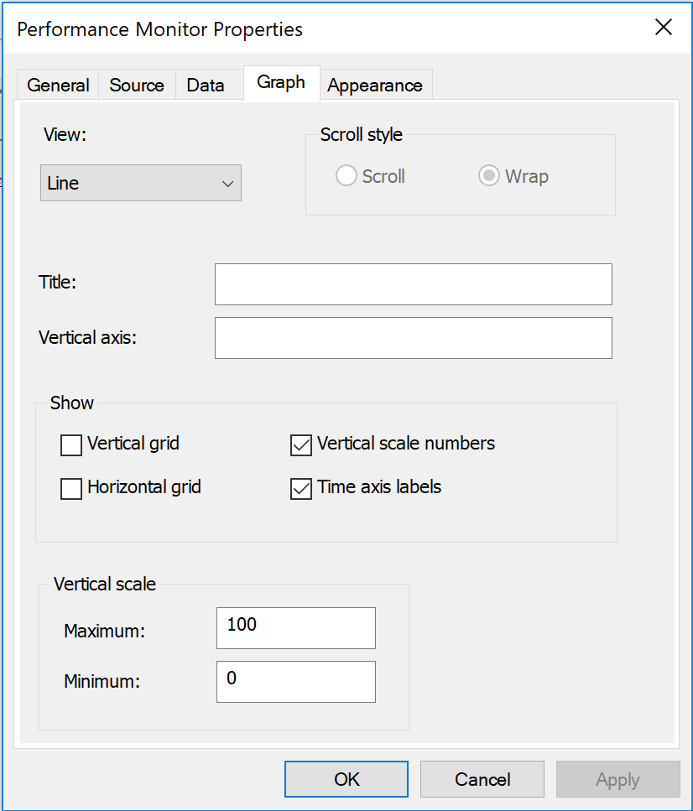
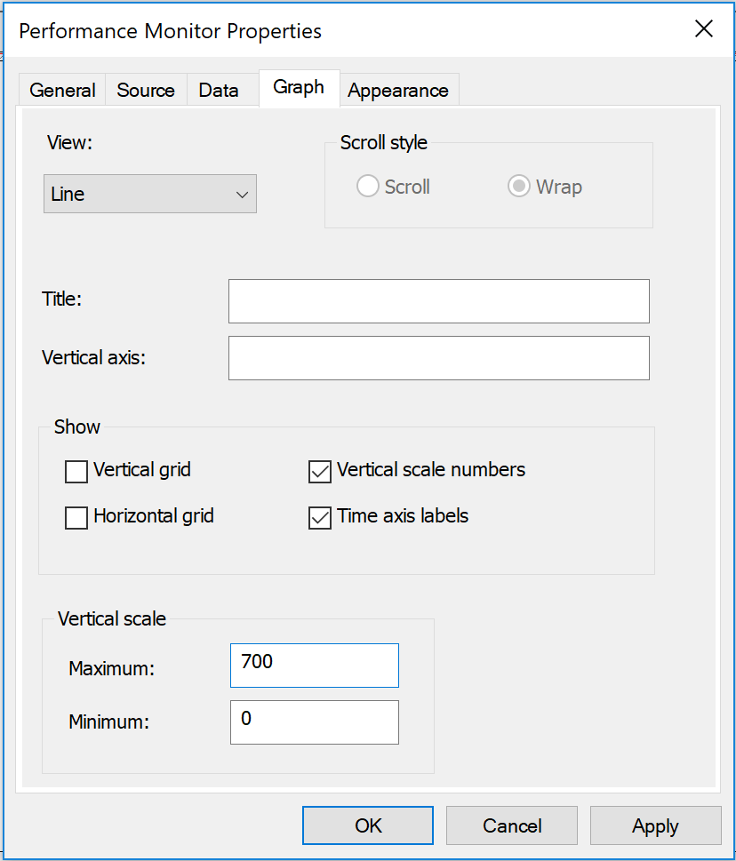

Change the Vertical Scale of the Graph
Adjusting the range of the chart can help when viewing counters of the same type globally for all counters:
Right-click anywhere on the graph and select Properties, click Graph, change Maximum and Minimum, and then click OK
Notes:
If you are working with counters that do not fit on the current chart range, it might be better to increase the chart range instead of auto-scaling the counters. This technique works best with counters of the same type or same unit.
For example, the \Process(*)\Virtual Bytes performance counter has an instance for every process recorded in the log or an instance for every process on the system (when looking at live counters). It might be tempting to auto-scale the entire counter instances, but an instance that is 10 times larger than the others would be reduced in scale by a factor of 10, making it look smaller than the others. This effect might be undesirable if you want to see which instance is the largest. In this case, increasing the maximum range of the chart until all of the counters fit will help you compare the counter instances.

Slide 24
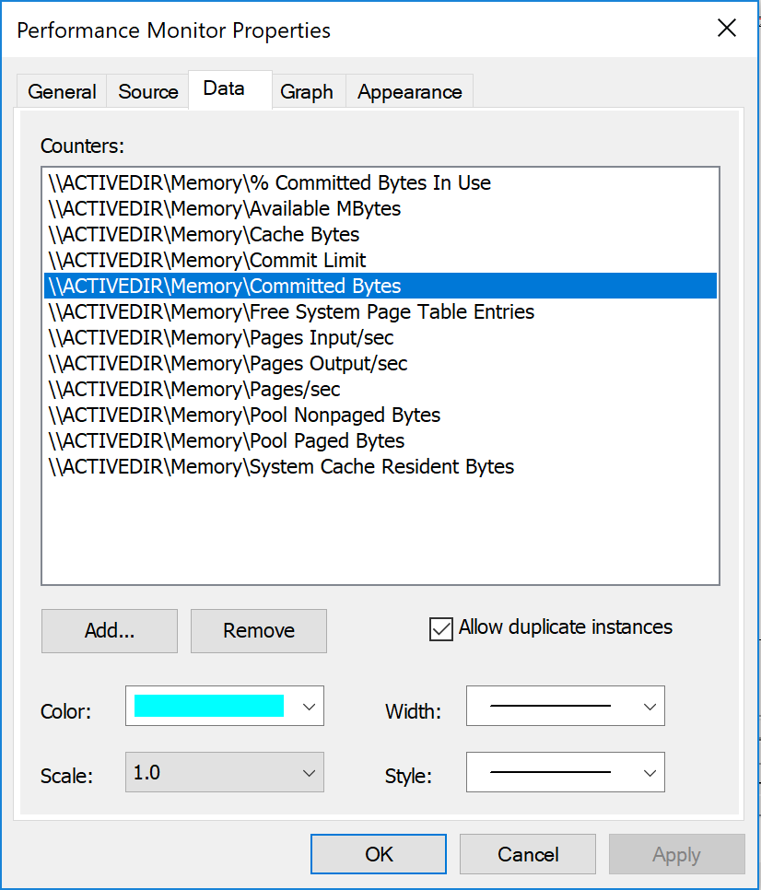
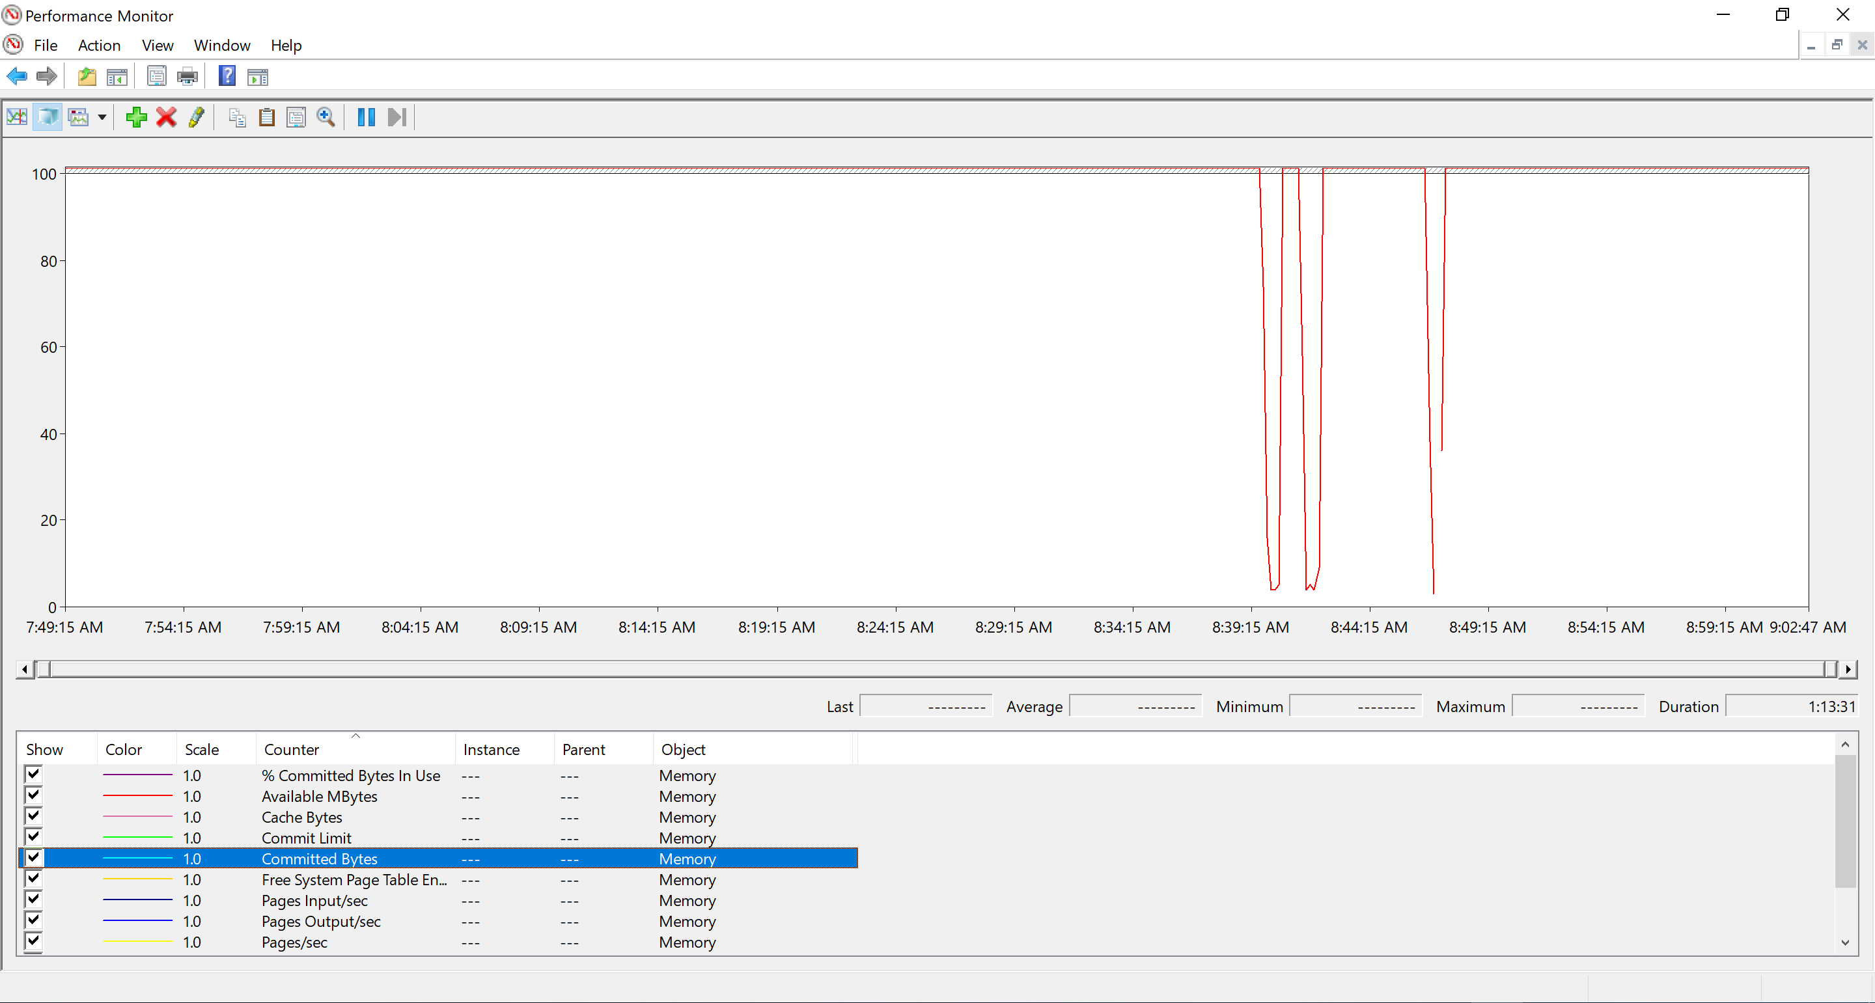

Change the Display of a Single Counter
You can adjust the color, scale, width, and style of a single counter:
Right-click the graph and select Properties.
Click Data.
Select the counter and change the values.
Click OK.
Notes:
You can adjust the properties of a single counter instance, including the line color, thickness, style, and scale of the counter instance.

Slide 26
Counter views

Slide 27
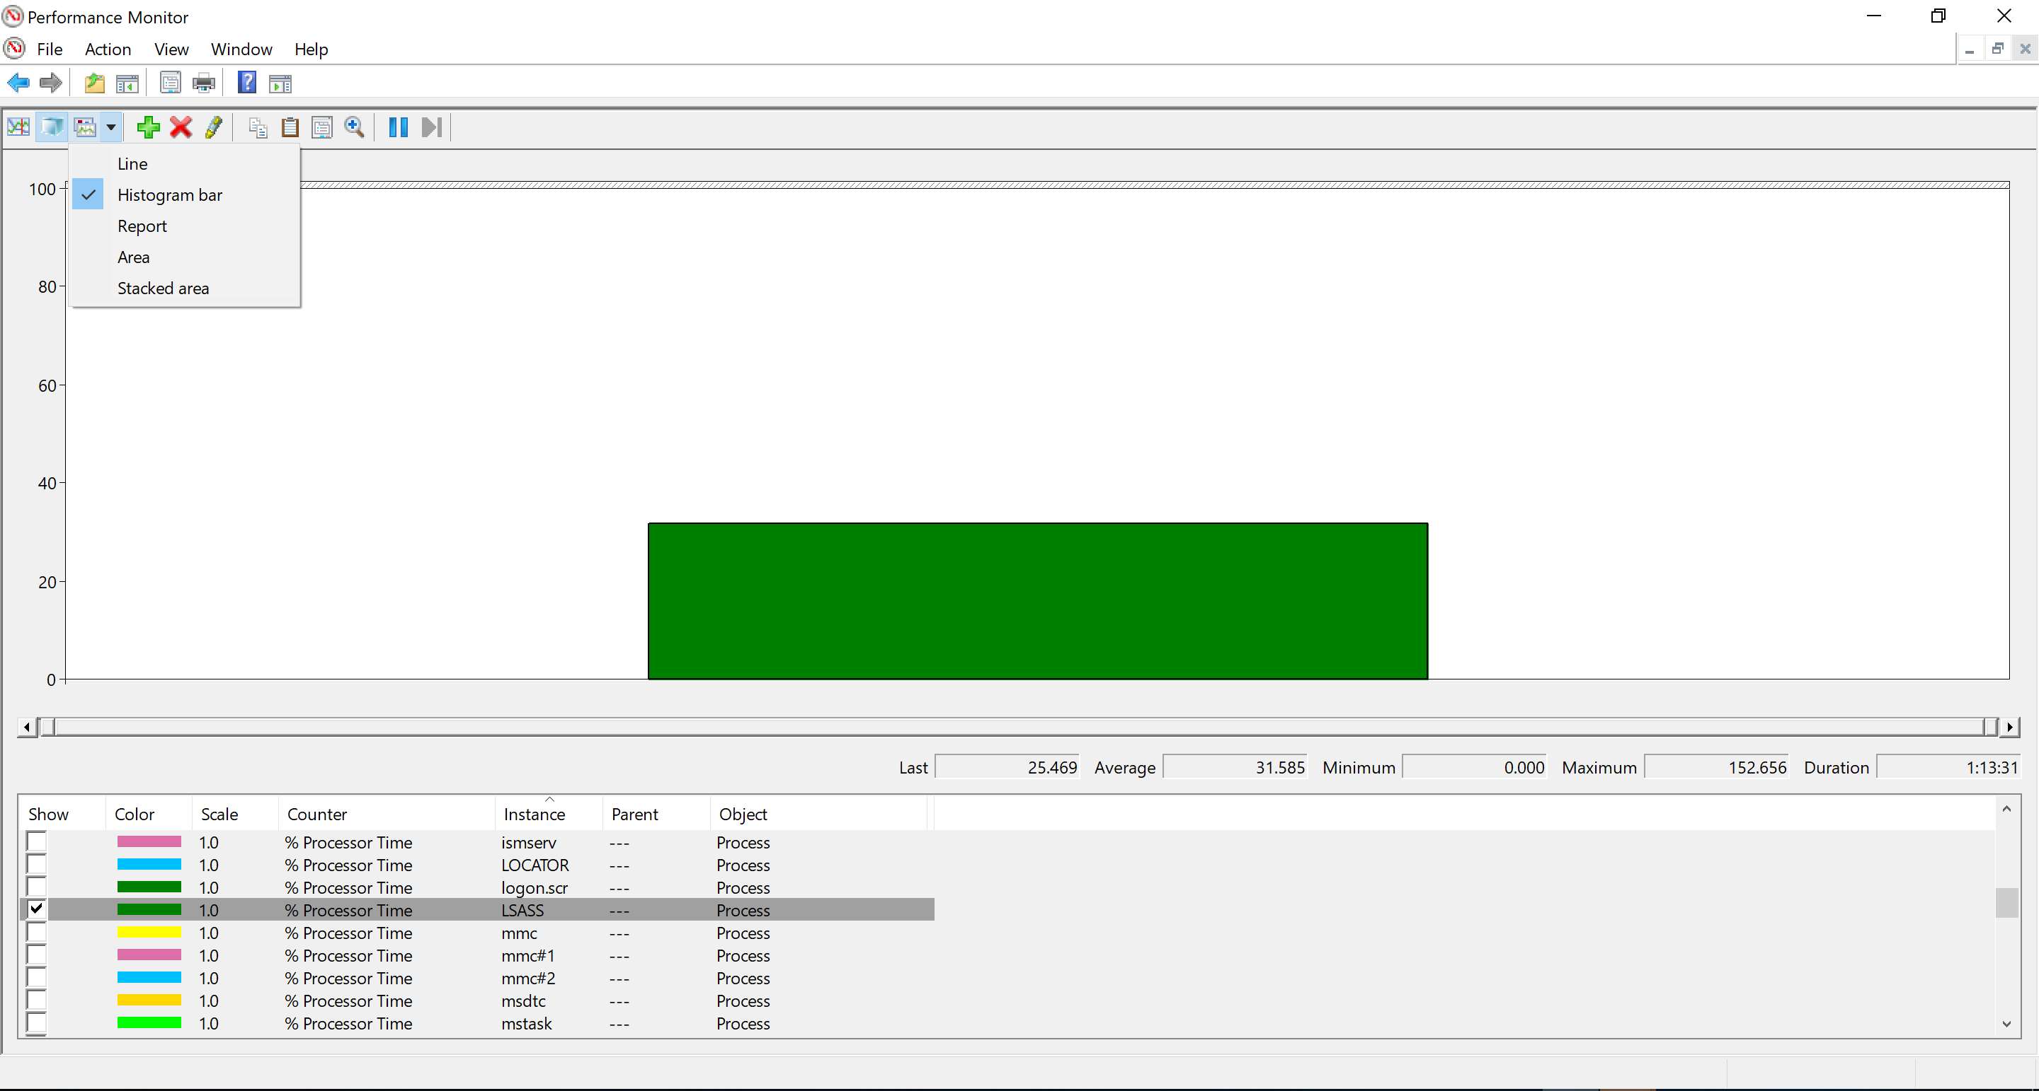
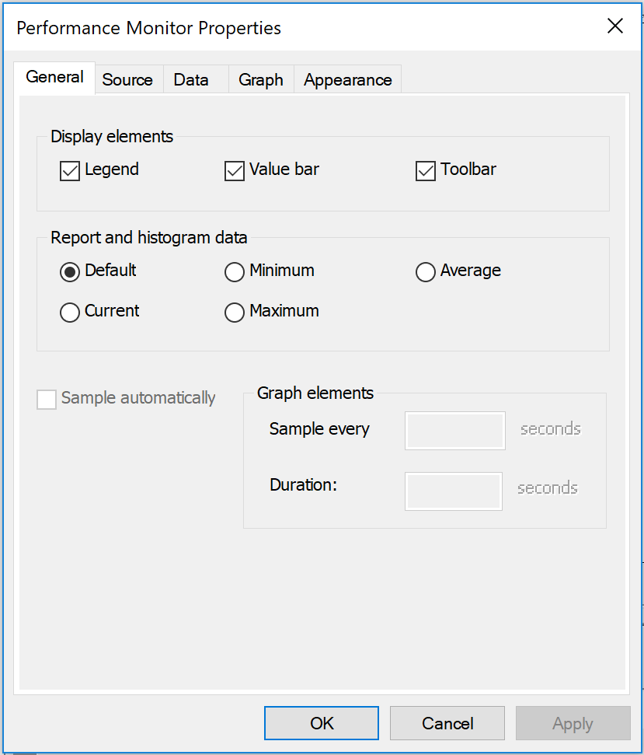
View as a Histogram
The histogram view shows counter values in a bar chart. Only one value can be shown at a time
To view a histogram, click the Graph Type button , and then click the Histogram bar
To change which values appear in the histogram:
Right-click the histogram and select Properties.
Click General tab, and then select the values.
Note: Performance Monitor does not dynamically add or remove counter instances
Notes:
The Perfmon has a histogram view, which presents the counter values in a bar chart. Only one value of each counter instance can be shown at a time, and you can choose which value to show. This view can help you visually determine which counter has the highest value and how that counter relates to other counters.
For example, this view is good for seeing which instance of \Process(*)\% Processor Time is the highest. However, remember the Perfmon does not dynamically add the counter instances—which means, the new counter instances are not automatically added to the view. Other tools, like Task Manager and Resource Monitor, can show new process instances as they come and go

Slide 28
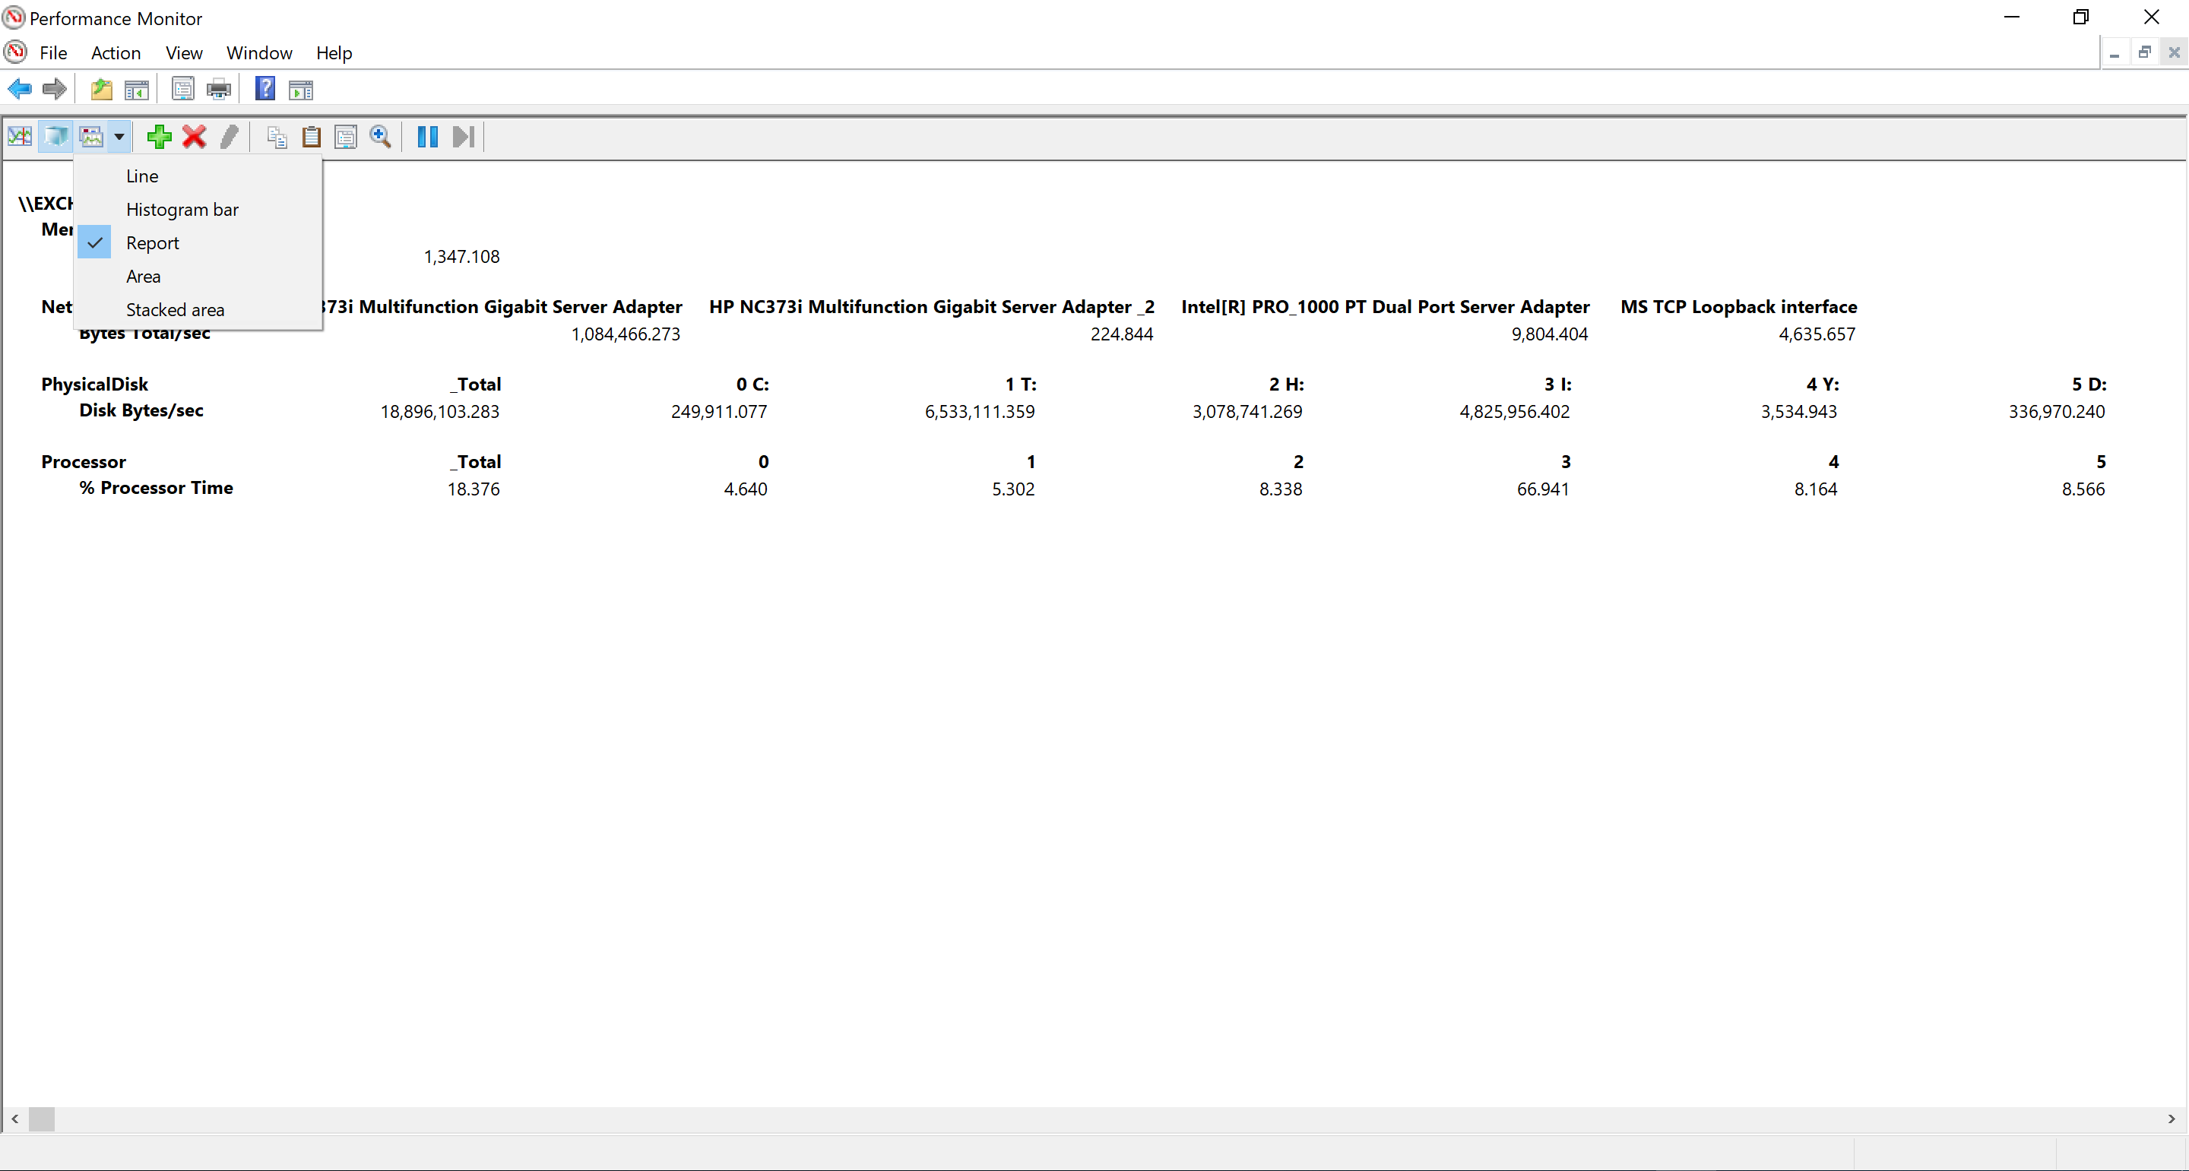
View as a Report
You can view the real-time minimum, average, maximum, and current values of different counters as a report:
To view a report, click the Graph Type button , and then click Report
To change which values appear in the report, right-click the report, select Properties > General, and then select the values
Notes:
The Report view is another way of viewing performance-counter data. In this view, the counter values appear as a single value, similar to the histogram view, but the data appears as text. This is helpful when you are looking at many counter instances at the same time. This view is commonly used for dashboard views of many computer systems and many different resources.

Slide 29
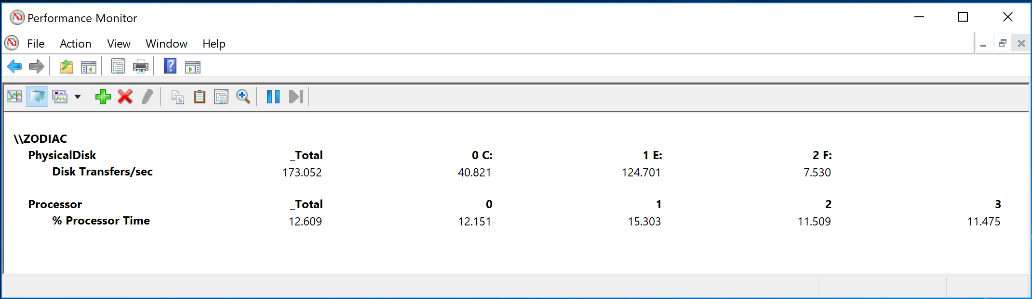
The _Total Counter Instance
_Total is a special counter instance, found on many counter objects, that might be a sum or average of all of the counter instances
Sum
equals
+
+
not equals
+
+
+
Average
Notes:
The _Total counter instance is a special counter instance. It is typically a sum or the average of all of the counter instances of a given counter. This instance does not exist for all the counter objects. Each counter object might implement this counter instance differently, so ensure to understand how it is calculating the values.

Slide 30
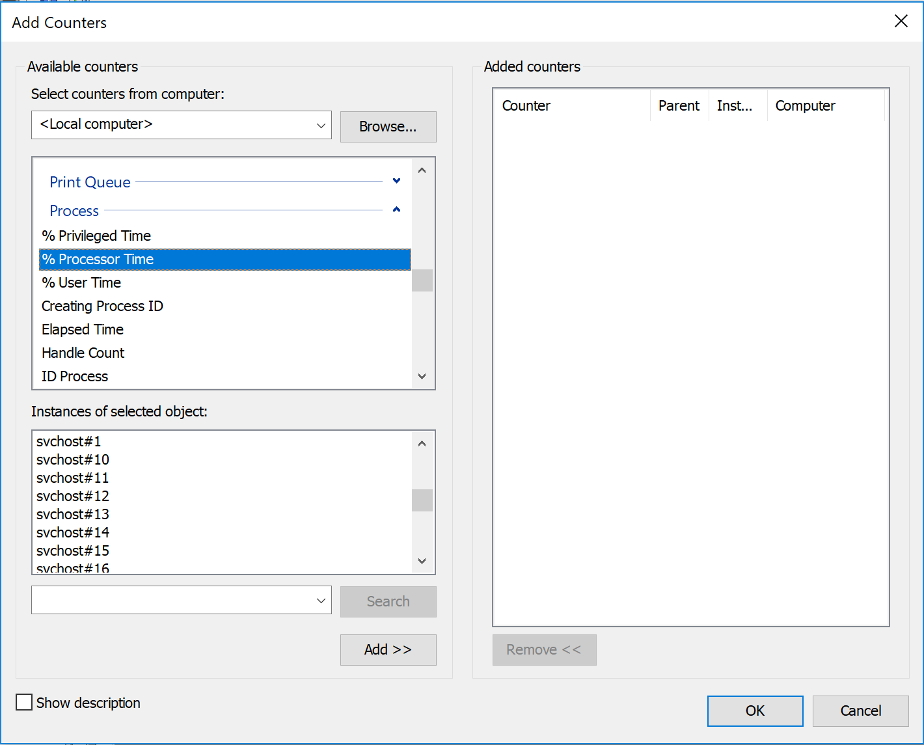
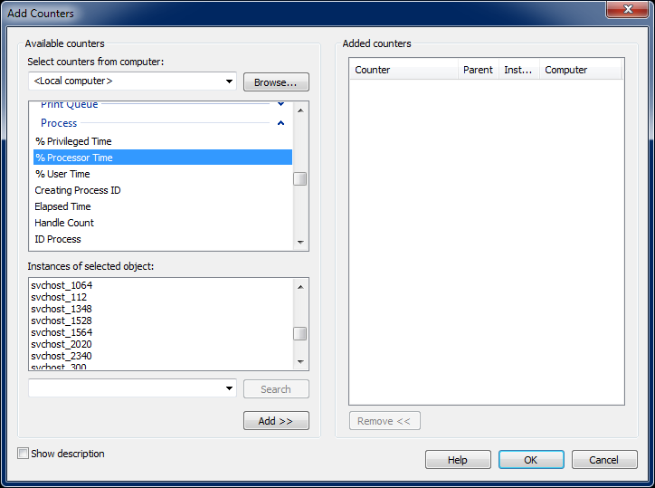
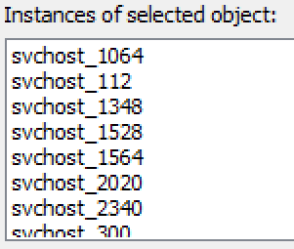
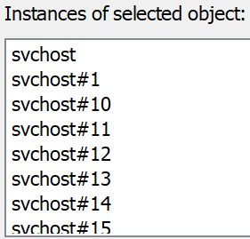
Add Process IDs (PIDs) to Names of Instances
The ProcessNameFormat registry key adds the Process ID (PID) of each process to the names of the counter instances:
To add the PIDs, add as a DWORD or set the ProcessNameFormat registry key in HKLM\SYSTEM\CurrentControlSet\Services\PerfProc\Performance to 2, and then restart Performance Monitor
Before
After
Notes:
Every instance of a counter must have a unique name. The Perfmon deals with this by adding a suffix of #x to each counter instance of the same name, where x is the lowest number available. The Process counter object commonly has multiple instances with the same name.
For example, services in Windows and Windows Server are hosted by surrogate processes, which are called service hosts or svchost.exe’s. If every service had a process, a lot more processes would be running. Many of the services have low overhead, so it makes sense to consolidate multiple services into a process. In any case, this results in a lot of svchost.exe’s, and the Perfmon needs to create a lot of #x suffixes to make them unique.
Windows XP, Windows Server 2003, and later support the ProcessNameFormat registry key, which changes the behavior of the Perfmon to display the Process object instances as <ProcessName>_<ProcessID>.
There is a process counter (\Process(<process>)\ID process) that can be utilized to find information (Process ID) and also that which utilizes this format. This approach may be better than enabling the registry key to prevent MPs from being unable to report data.
NOTE: The Management Packs (MPs) like SCOM may not alert if you selected a specific process PID, and the PID changed due to the process being closed and a new instance started in its place.

Slide 32
Knowledge Check
What is the importance of the Minimum and Maximum values of a counter?
When is it best to adjust the minimum and maximum vertical range of the Performance Monitor chart?
When is it best to Scale Selected Counters?
What kind of data is it best to display as a report?
Notes:
The last, minimum, maximum, and average fields are not multiplied by the scale. The scale multiplier can be misinterpreted.
Change the vertical scale of the graph for counters of the same type.
Use the Scale Selected Counters feature to set the scale multiplier for counters of different types.
You can view the real-time minimum, average, maximum, and current values of different counters in Report view.

Slide 33
Manage Perfmon Logs from the GUI

Slide 34
Learnings covered in this Unit
Creating a Counter log
Counter Log Templates
Counter Tuning HDD Consumption and Impact of Data Capturing
Tuning Log File Fomrat and Sample Interval
Scheduling a Counter Log

Slide 35
Creating a Counter log

Slide 36
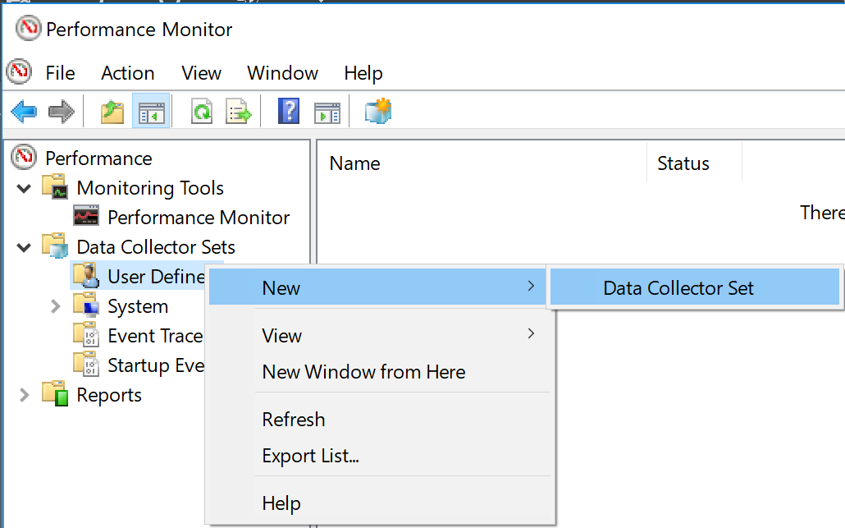
Creating a Counter Log by Using Data Collector Sets
You can create logs from the Data Collector Sets node
Expand Data Collector Sets, right-click User Defined, point to New, and then click Data Collector Set. The Create new Data Collector Set Wizard starts. Finish the wizard
Notes:
You can create a data collector set using the New Data Collector Set Wizard.
To start the wizard, right-click the User Defined node and select New > Data Collector Set.

Slide 37
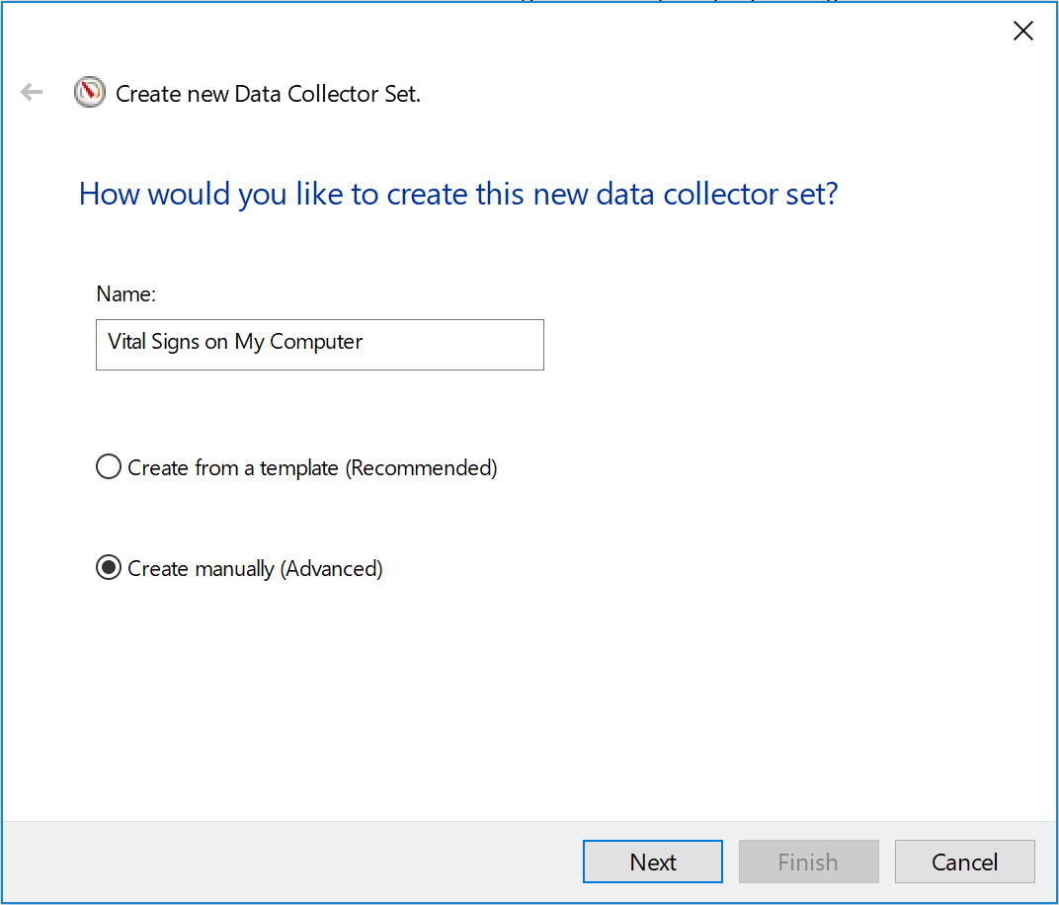
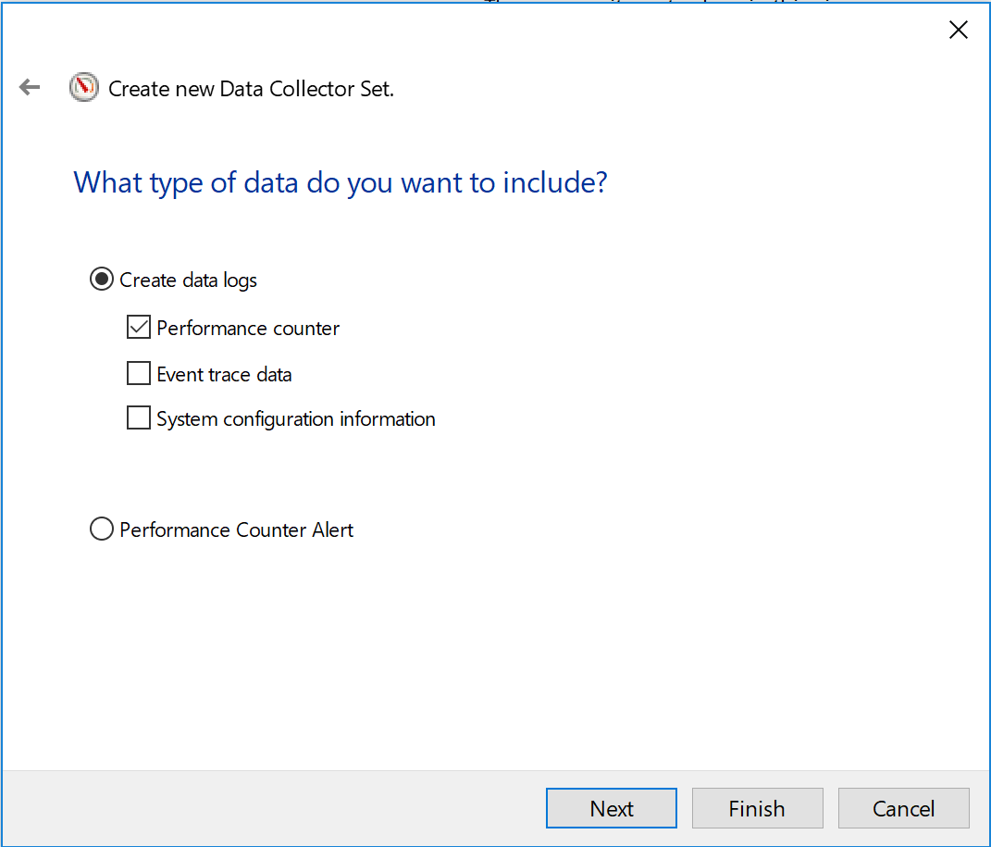
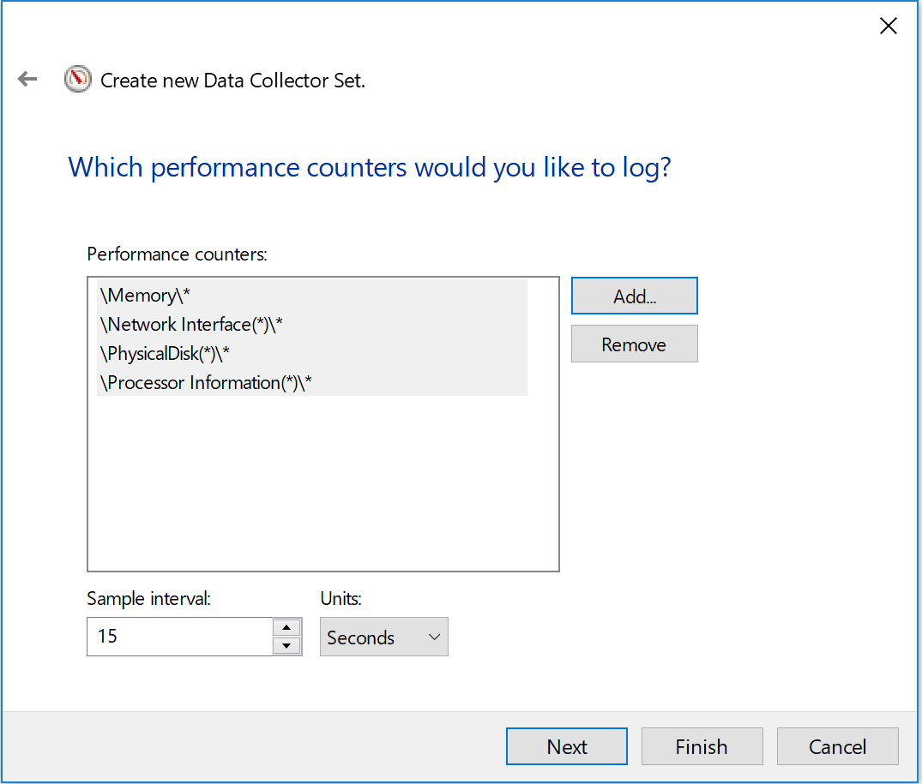
Creating a Manual Counter Log
You can create a log (Data Collector) manually, by using the Create new Data Collector Set Wizard:
Select Create manually (Advanced) > Create data logs > Performance counter.
Select the performance counters that you want to log and click Add.
Select the sample interval, and then click Finish.
Back button is here
Notes:
After starting the New Data Collector Set Wizard, create a manual counter log. The figure on the slide shows you how to create a new Data Collector that gathers performance-counter data and writes it to a log file. Later, we will export the settings from this Data Collector to create a template that we can reuse on other servers.

Slide 38
Creating a Counter Log by Using a Template
You can create logs from templates (.xml):
Expand Data Collector Sets
Right-click User Defined and select New > Data Collector Set
The Create new Data Collector Set Wizard starts
Notes:
Now that you have a new data collector set template, you can use the template to create a new data collector set. You can use the template only on computers that are running Windows Server 2008 or later.

Slide 39
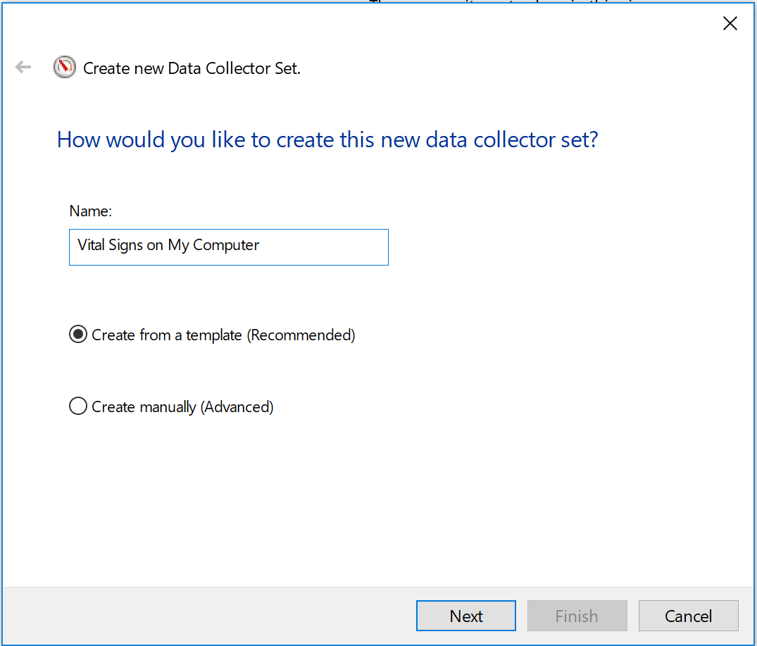
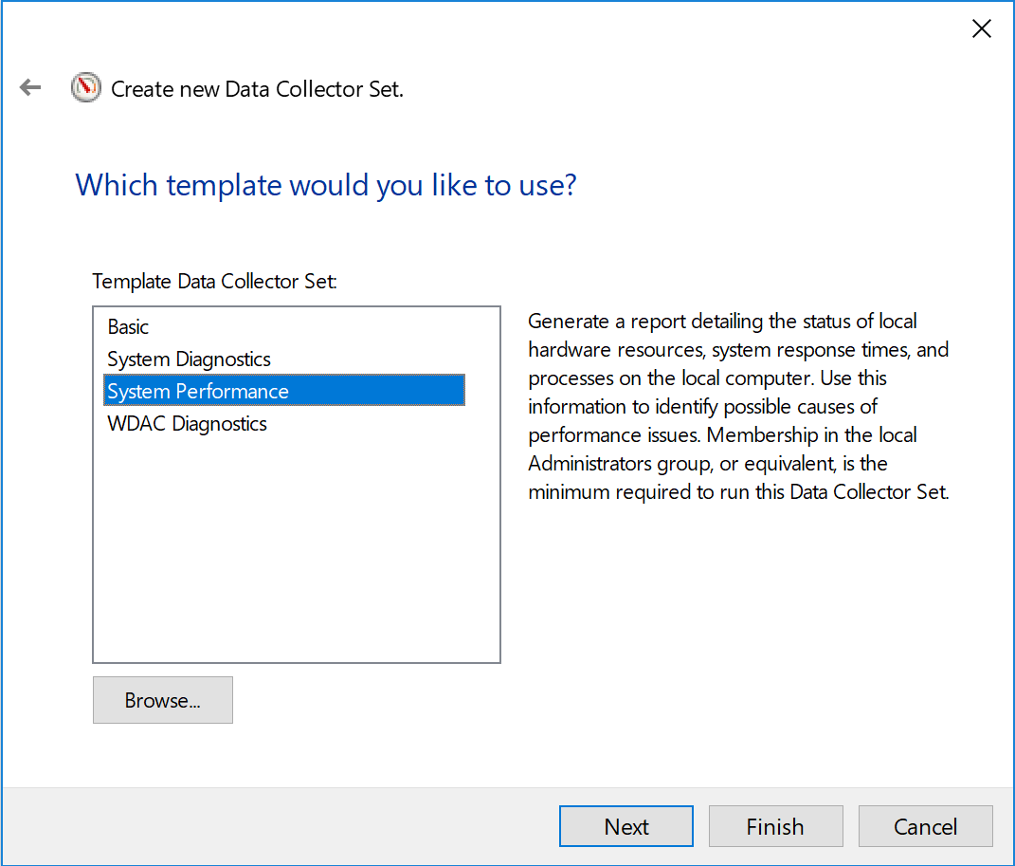
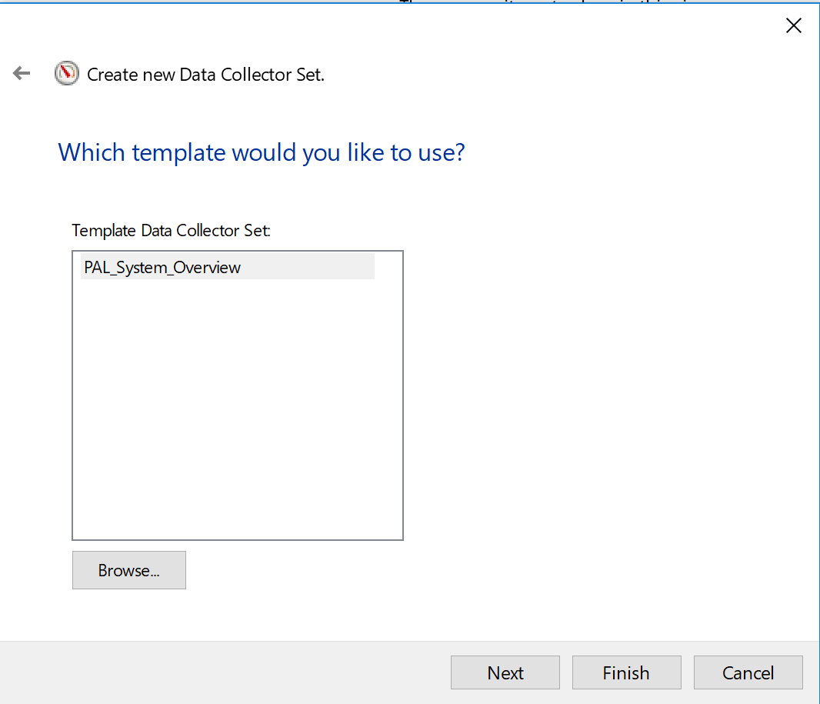
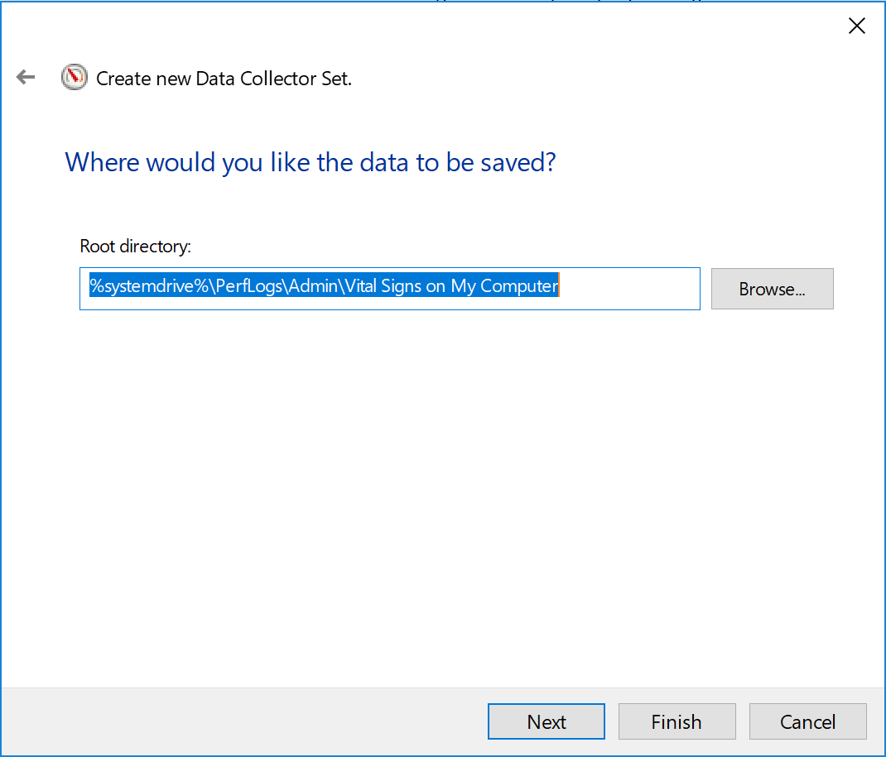
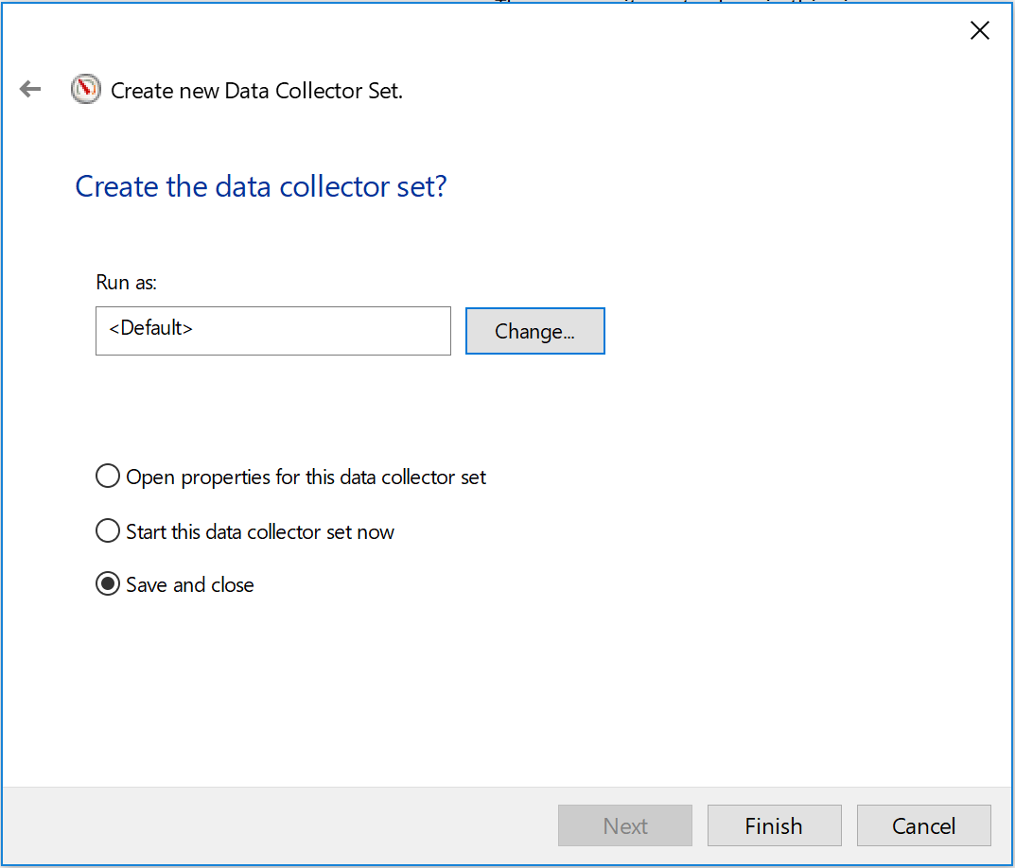
Creating a Counter Log by Using a Template
Click Create from a template (Recommended)
Click Browse
Select the .xml template that you want to use, and then click Finish
Notes:
To create a new data collector set from a template:
Select Create from a template (Recommended)
Browse to the data collector set template (*.xml) and then click Finish.

Slide 41
Counter Log Templates

Slide 42
Counter Log Templates Provided
Performance Monitor includes several templates
They are in the Vital Signs\Capture Templates folder
The templates for Windows XP and Windows Server 2003 are different from the templates for Windows 7/Server 2008, and Windows 8/Server 2012
The templates collect data for the local computer
They are not localized and they use only the English-US locale
The SQL Server templates are only for default instances of SQL Server
The counters for named instances of SQL Server are unique (for example, \MSSQL$UniqueName:Access Methods(*)\*)
Notes:
The software files provided with this class have a Capture Templates folder. The folder contains counter log templates (*.htm) for Windows XP, Windows Server 2003, and earlier, and it contains data collector set templates (*.xml) for Windows Server 2008 or later. There are templates for most of the major Microsoft server products. All of the templates are created for the English-US locale and might not work on systems using other locales.
The templates for SQL Server are for default instances of SQL Server. If a named instance of SQL Server is installed on a computer, the performance counters for that named instance are unique to the name used. Therefore, performance counters for named instances of SQL Server need to be manually added to a counter log or a data collector.
The PAL tool is aware of SQL Server named instances and can analyze them independently. With that said, the PAL tool exports counter log templates and data collector set templates for SQL Server as default instances of SQL Server.

Slide 43
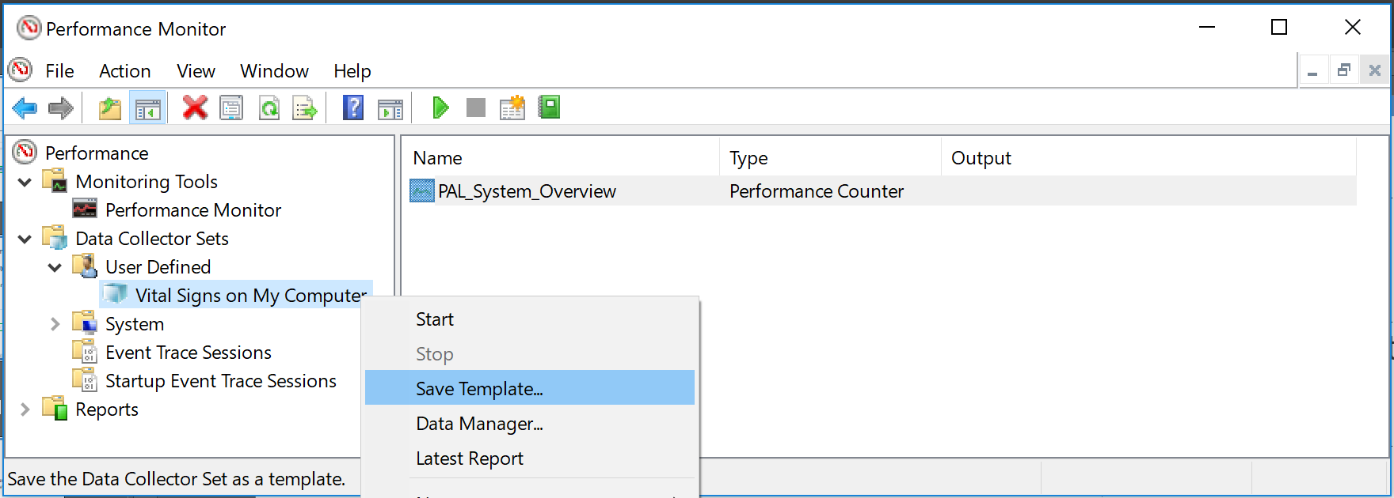
Saving a Data Collector Set Template
You can save a Data Collector Set template to reuse on other systems:
Expand Data Collector Sets, right-click the data-collector set that you want to save as a template, select Save Template, and then save as an .xml file
Notes:
Data collector set templates are helpful because you can save the settings from one computer and reuse the settings on other computers.
To save a data collector set template, right-click the data collector set and select Save Template
This starts a wizard to save the template.
Notice that the template file is an XML file. This format was introduced in Windows Server 2008. On Windows XP, Windows Server 2003, and earlier, the counter log template files are HTM files. The HTM counter templates are not compatible with Windows Server 2008, and later. Also, the XML data collector set templates are incompatible with Windows XP, Windows Server 2003, and earlier.
Note: The PAL tool can generate a counter log template (*.htm) or a data collector set template (*.xml) from the PAL threshold files. The PAL has a threshold file template for most of the major Microsoft Server products.

Slide 44
Counter Tuning HDD Consumption and Impact of Data Capturing

Slide 45
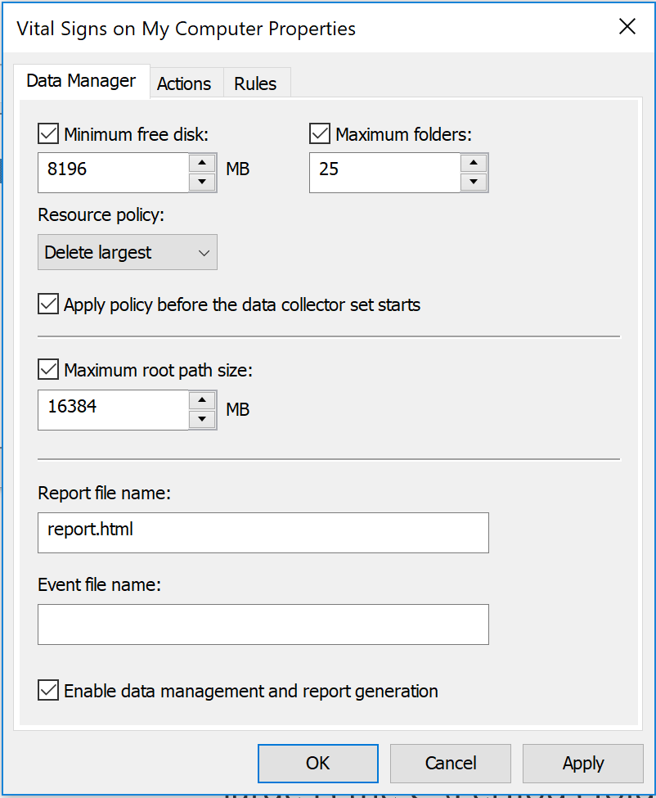
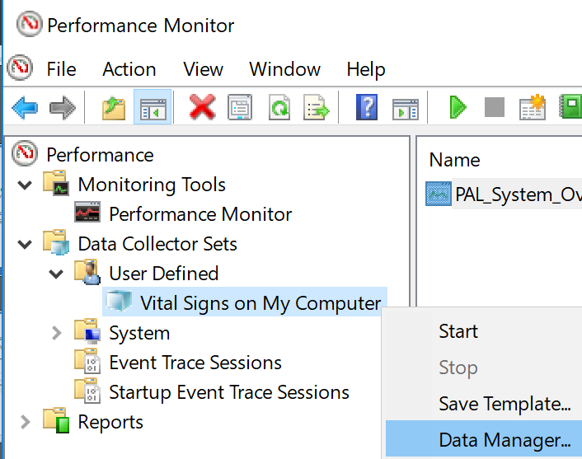
Managing Data Consumption of the Hard Drive
This allows the configuration of policies to prevent excessive usage of the OS partition (C:\Perflogs) where the performance data is saved
This is accessed by right-clicking a created template and selecting Data Manager
Minimum free disk invokes clean up when this value is reached (ex: 8 GB free)
Maximum root path size is how large is the C:\Perflogs folder is allowed to be with all subfolders
Notes:
For more information on Manage Data in Windows Performance Monitor, see: http://technet.microsoft.com/en-us/library/cc765998.aspx

Slide 46
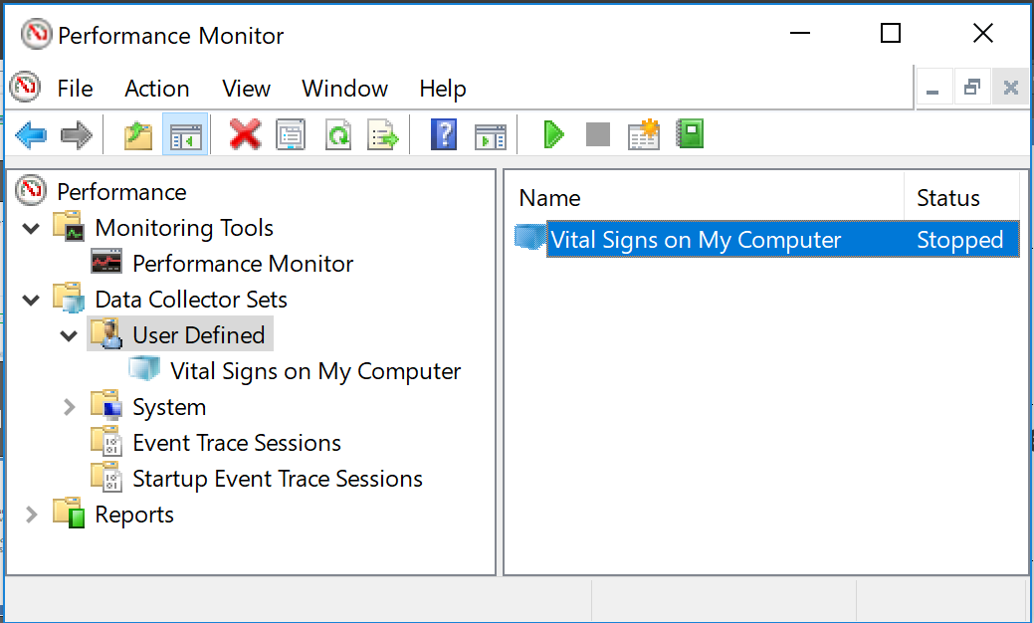
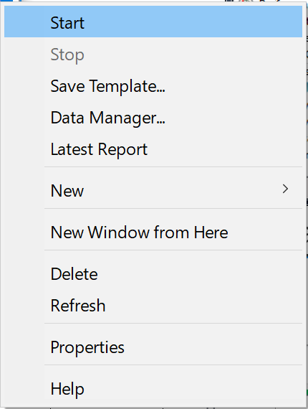
Starting/Stopping a Counter Log
To start or stop a log, use the Data Collector Sets node:
Expand Data Collector Sets, navigate to the log, and then click it
To start, either click , or right-click the log and then select Start
To stop, either click , or right-click the log and then select Stop
Notes:
To start or stop a Data Collector set, either use the user interface buttons or right-click the Data Collector set. By default, the Data Collector set creates a new counter log with an incremented suffix. This means that counter log data is not deleted between start and stop events. Be careful not to use up too much disk space.

Slide 47
Considerations for Selecting Counters
Choosing an entire Object (example: \Processor(*)\*)
All counters and instances are in the log
May limit total duration of capture if using a circular log file due to capturing unused counters. Collecting entire objects is the largest disk footprint
Choosing a specific Counter (example: \Processor(*)\% Processor Time)
Smaller disk footprint
Good balance between troubleshooting and disk space
Instances (example: \Processor(_Total)\% Processor Time)
Smallest disk footprint
Does not capture new instances
Best for analyzing trends over the long term
Notes:
When specifying the counters to put in the counter log (data collector set), consider how much data you want to collect. If you collect the entire objects, such as the Process object which looks like \Process(*)\*, you can collect all of the counters and instances. This means that, for every process that is on the system (including the processes that start up), there are many counters that are logged to it. If you log too much, the counter log file can become very large. However, if you log too little, you might not have sufficient data to troubleshoot the issues.

Slide 48
Impact of Capturing Counter Data
Varies from 0 % to 10 % of total CPU:
However, it is typically less than 1% of 1-2 CPU’s
Performance Monitor uses about 100 -150 MB of RAM
Typically 64 kb - 256 kb is written to the log file per sample
Depends on the sample interval, duration, and number of counter instances
To minimize the impact:
Avoid logging the \Thread(*)\* object
Use counters instead of entire objects
Log only the data that you need
Consider setting sample rates around 15 seconds rather than 1 seconds per sample, this helps keep the impact under 3% of CPU
Notes:
Logging of performance counter data probably had a lot more overhead back in the Windows NT 4.0 days, but on modern computer systems the overhead is trivial. The only exception to this is the \Thread(*)\* object. This object creates a series of counters for each thread on the system. Systems can handle millions of threads, so when you multiply this by the number of counters in the Thread object, you can get a lot of counters being logged. Avoid using the Thread object unless it is necessary for the problem you are trying to resolve.

Slide 50
Tuning Log File Fomrat and Sample Interval

Slide 51
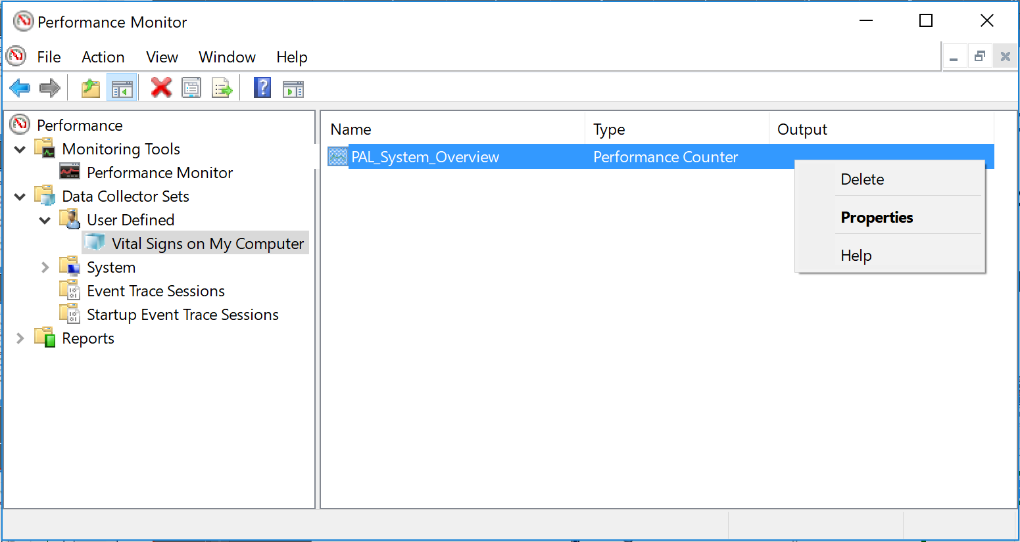
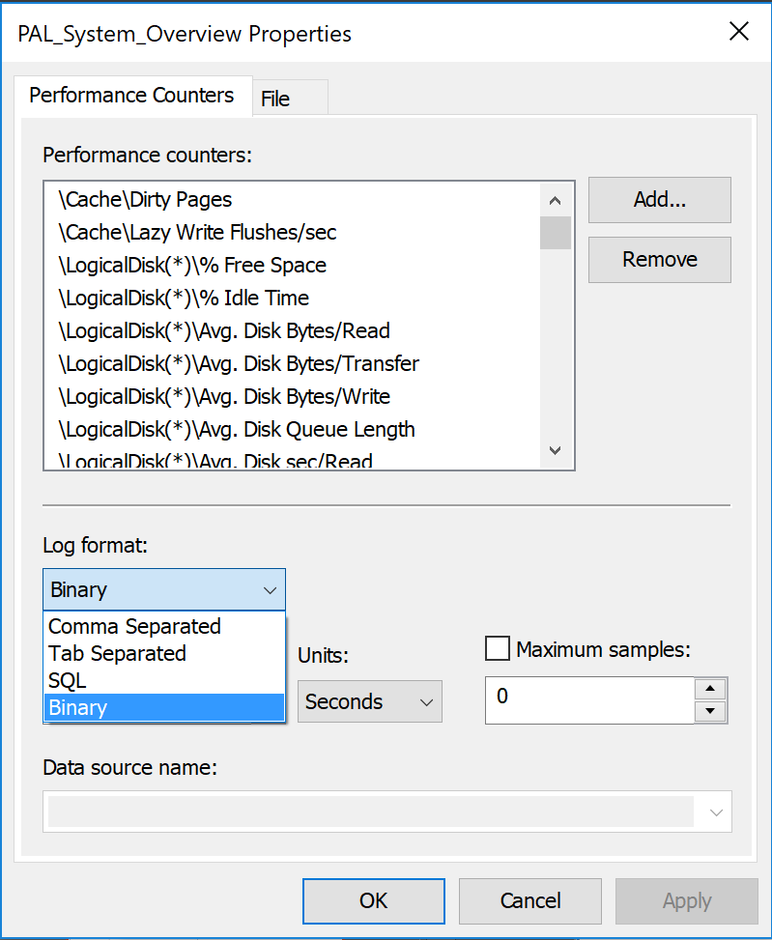
Selecting the Counter Log File Format
You can choose from several file formats for the log. The next slide describes the options:
Expand Data Collector Sets, right-click the Data Collector, select Properties, select a Log format, and then click OK.
Notes:
You can select the counter log format from the data collector properties. The options are binary (*.blg), comma separate values (*.csv), tab separated values (*.tsv), and SQL tables. The SQL table selection requires a data source name (DSN).

Slide 52
Capture File Formats
Binary (.blg):
Default and is the recommended format to use over .CSV and SQL
Very portable
Can log new process counter instances
Can be relogged to .CSV files if required
Comma-separated values (.csv) and tab-separated values (.tsv):
File size is smaller than in binary format
CSV logs cannot log process instances that occur after the log starts. For example: Cluster disks that failover to the another node
Easy to parse with other tools
Notes:
Always, consider logging in binary format (*.blg) over CSV or SQL. This is because the CSV and TSV text file formats do not log new counter instances after the log starts, while binary logs can.
For example, if you start a CSV counter log, and then you restart all of the IIS worker processes, none of the new IIS worker processes are in the log. This is because once the CSV or TSV counter log starts, the schema of that log cannot be increased, preventing any new counter instances. This is also true for cluster resources. If the resources failover, they will not be collected in the log on the server they moved to
The binary (*.blg) and SQL formats dynamically increase, so these formats log every new counter instance. Also, counter logs using the binary format retain the automatic counter scales. If you use a CSV counter log and browse to the \Process(*)\Virtual Bytes counter, all of the counters are at the 1.0 scale. Many processes use gigabytes of data, so this scale is too small and there is no way to change the scale to a specific scale for all of the selected counters at once. A binary log retains the 0.000001 scale for all of the Virtual Bytes counter instances. Effectively, it is easier to work with binary counter logs.
You can use the SQL database logging for the high-end enterprise logging of the performance counters like a trend analysis project, but this topic is not covered in the scope of this workshop.
Windows Server 2008 and Windows Server 2012 have an improved binary log format, which uses the same file extension of *.blg. This format is incompatible with the earlier versions of Windows and Windows Server. Therefore, if you capture a binary counter log on Windows Server 2008 or Windows Server 2012, you cannot open that log file on the earlier versions of Windows Server 2003.

Slide 53
Capture File Formats (continued)
SQL Server database:
Useful for SQL Reporting Services and for other analyzers
Requires that you know how to use and access SQL databases
Can capture new process instances

Slide 54
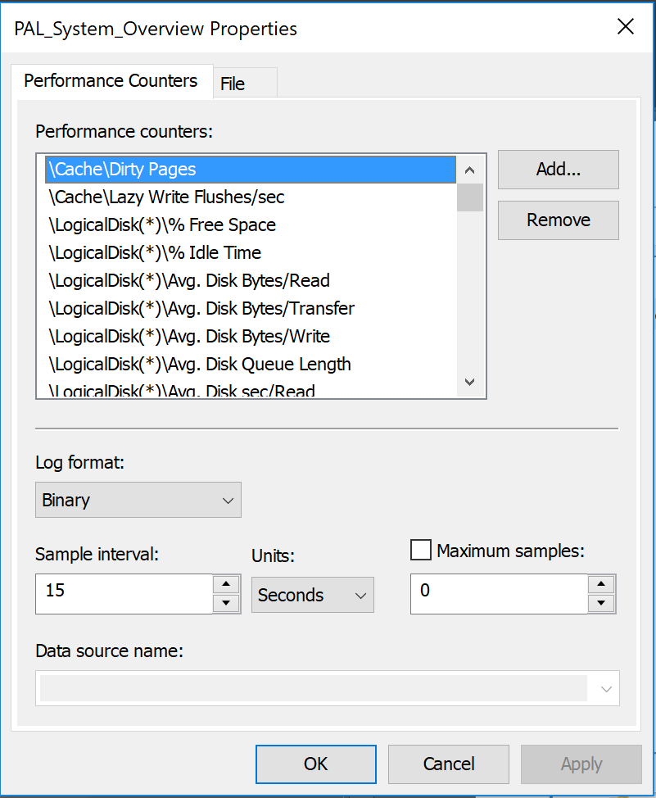
Selecting the Sample Interval
Expand Data Collector Sets
Right-click the Data Collector and select Properties
Enter a value in the Sample interval field
Click OK
Notes:
You can adjust the counter log sample interval in the data collector set. This setting determines how often a sample of data can be collected from the entire counter instances that are specified in the data collector.

Slide 55
Choosing a Sample Interval
Sample interval: Determines how often you log the data
Some counters provide only a point in time value. For details, see the counter descriptions
Considerations:
A small sample interval results in a large file, perhaps a very large file, which can be difficult to use
A large sample interval can result in too few data points, which are statistically unreliable
Too many samples can result in a high density capture, which may not display high and low points on the graph until zoomed
As a starting point, divide the overall time by 1000
1000 data points fit well into the Performance Monitor chart
Example: 24 hours / 1000 = 1 minutes, 16 seconds
Example: 20 minutes / 1000 = 1.2 seconds
Notes:
It is important to collect the counter data often enough to be useful, but not so often that the log becomes too large to manage. Many counters are point-in-time counters, i.e., they provide a value based on what is going on at the moment of collection. If a counter was at 10 during a long period of time, and then it suddenly spiked to 1000 when it was collected, the counter might report 1000, which is not a true average. Other counters, such as the Avg. Disk sec/Read and Avg. Disk sec/Write performance counters, track every disk I/O and when the last counter collection occurred, so when the counter is collected. it shows a true reflection of the average between the collection times. The point is that you should try to strike a balance. Collect the counters often enough that they are relevant to the problem you are trying to solve, but do not collect them so often that you have extremely large log files.
A good starting point is to divide the number of expected data points by a 1000. Use 1000 samples because it keeps the counter logs down to about 200 MB over a 24-hour period (this is a very rough estimate). Also, Windows XP and Windows Server 2003 Performance Monitor can only display 500 data points. Windows Server 2008 and Windows Server 2012’s Performance Monitor can display 1000 data points.
If you are willing to use a circular performance log or a fixed log size then your sample rate can be increased since there is no longer a concern that it will.

Slide 57
Scheduling a Counter Log

Slide 58
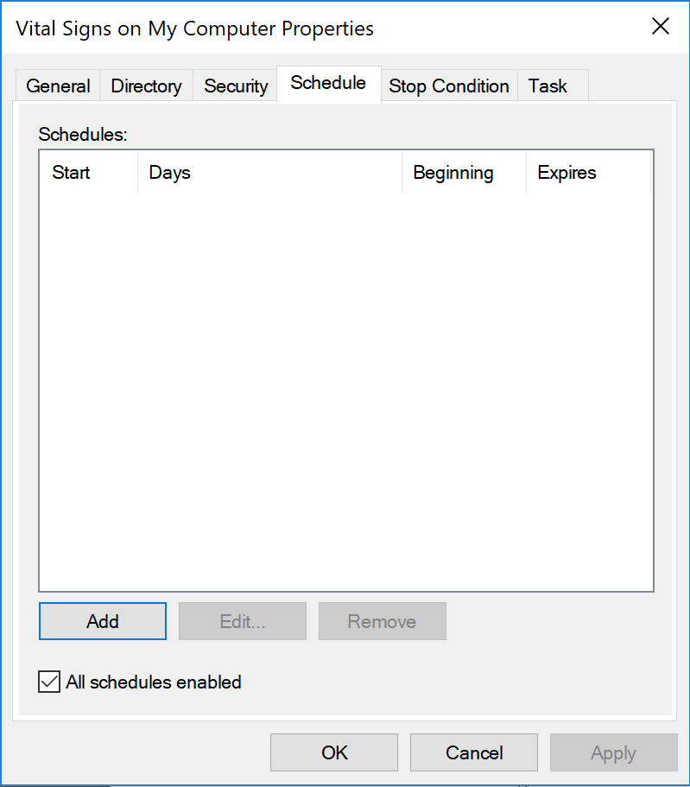


Scheduling a Counter Log
You can schedule when a log runs. Also, you should always set a stop condition to prevent unnecessary logging
To set a schedule:
Right-click the Data Collector Set and select Properties
Click Schedule and then specify a folder action
To set a stop condition:
Click Stop Condition, and then specify a stop condition
Notes:
Ensure that you specify a stop condition for a counter log, even if you intend to stop the counter log within a short time. We all get busy, and if you happen to forget about the counter log and it runs for a few months, you might accidentally cause the system to run out of disk space. For this reason, always consider a stop condition even if you fully intend to stop it before then.

Slide 59
File Sizes of Counter Logs
The sizes of the log files vary greatly, depending on the sample interval, duration, and number of counter instances
Example: 24 hours @ 1 minute sample interval of common OS counter objects can range from ~50 MB to ~400 MB
Ensure that there is enough disk space for the log file
Consider scheduling an end time for the logging
Consider using a circular log file with a fixed size (for example, 500 MB to 1 GB log file). It loads quickly into memory, will easily fit into most workstations free memory available, and does have to be divided to work with.
Notes:
A typical counter log capturing most of the counter objects mentioned in this workshop is generally between 50 MB and 400 MB in size. Ensure that there is enough free disk space to accommodate a counter log of the estimated size before you start the data collector set, and consider adding a stop condition to the data collector set.

Slide 60
Circular Log File
Continuously overwrites itself
Never grows over the maximum size, which you specify
Is especially useful for problems that occur rarely
Similar to a black box flight recorder on aircraft
The start time is the original start time of the logging
Notes:
A binary circular counter log continuously overwrites a file.
For example, if you create a log with a maximum size of 200 MB and set it to be circular, it initially fills up the 200 MB file, and then it overwrites the old data as it goes. This is called a black box counter log because it is similar to a black box flight recorder on a commercial aircraft. You can have a binary circular log running forever and never have a log file over the maximum size. Just stop the log if a problem occurs
A good size to start with is 200 MB, because it is normally large enough to handle at least 24 hours of data at 1-minute collection intervals.

Slide 61


Creating a Circular Log File
A circular log file continuously overwrites itself
Go to Properties of the Data Collector Set. Click the Stop Condition tab, and then set the Maximum Size
Go to Properties of the Data Collector. Click the File tab, and then select Circular
Data Collector properties
Data Collector Set properties
Notes:
To create a binary circular log file, you must set a maximum size for the data collector set —the Circular log mode is disabled (grayed out) by default until you set a maximum size.
Set the size in the data collector set properties.
Navigate to the data collector (a node off of the data collector set) properties.
On the File tab, select Circular
In the example on the slide, the maximum size is set to 200 MB, and the log mode is set to Circular.

Slide 62


Loading a Counter Log
To view the data in a log:
Click , then Source
Select Log files
Click Add, and then click the log file
Notes:
After capturing counter data in a counter log file or database, you can open the log file or database by using the View Log Data in the Perfmon menu. To load a counter log file:
Select Log files.
Click Add and browse to the counter log file. Click OK.
To load a SQL database table, select System DSN and Log set.
Once they are loaded, no counters appear in the chart. This is because the log might have thousands of counter instances in it. Click the green “plus” button to browse the counters that are in the log and add them to the chart.

Slide 63
Loading a Counter Log
Windows XP and Windows Server 2003 cannot open logs that were recorded on Windows Vista/Windows Server 2008, or Windows 7/Windows Server 2008 R2, or Windows 8/Windows Server 2012, or Windows 8.1/Windows Server 2012 R2, or Windows 10/Windows Server 2016
Windows Vista/Server 2008 and later can open logs captured on any version of Windows and Windows Server
You can add counters to Performance Monitor after you load a log
Notes:
This slide is a review of some of the key concepts that this section covers.

Slide 64
Local vs. Remote Data Collection
Local:
Better for troubleshooting problems, such as disk I/O
Less likely to have gaps in data
No network overhead
The data will match the time stamps of the local event logs
No issues due to collecting 64-bit data from a 32-bit Windows OS
This is the preferred approach for troubleshooting
Remote:
Better for analyzing large-scale trends
The data has the time zone of the computer that is capturing the data, not the computer that is generating the data. This can cause confusion
Network issues, such as jitter, latency, and saturation, can cause gaps in the data
Notes:
The counters can be viewed live or can be captured remotely from any number of computers. Try to gather the performance counter logs and data collector sets locally on each computer because the computer captures the counter data to a local disk. If you collect counter data locally, you are less likely to have gaps in the data, there is no network overhead (which can be significant), and you do not need to take time zones into consideration.
The time of the computer that is capturing the data is used.
For example, if a computer on the Pacific Time captures the counter data from a computer on the Eastern Time, the counter data is logged in Pacific Time. This means that whoever looks at the counter data must know that the data is offset by the time zone difference

Slide 66
Knowledge Check
Which log file formats do not capture new counter instances?
For troubleshooting, why is it better to collect data locally than remotely?
What is the potential impact of capturing a counter log on a production server?
How can the time-range control help with high density logs?
Notes:
After a .csv or .tsv counter log is started, it does not collect new counter instances—use binary (.blg).
Local counter collection is more reliable, has no network overhead, and is not affected by time-zone differences.
Counter logging generally has trivial amounts of overhead on servers, as long as the Thread object is not being gathered.
The Time-Range control helps to zoom in to a time range to see details.

Slide 67
Manage Perfmon Logs from the command Line

Slide 68
Learnings covered in this Unit
Intro Parameters for Logman and Log creation
Create a remote log and working with collector sets
Repairing Counters

Slide 69
Intro Parameters for Logman and Log creation

Slide 70

Use logman.exe
Logman.exe is a command-line tool that manages data-collector sets and is generally superior vs. using the GUI to manage large numbers of computers running captures
Great for scripting and for remote administration of data-collector sets (create, delete, query, update, start, and stop data collector sets)
Requires administrator rights
Notes:
Logman.exe is a command-line tool that manages data collector sets either locally or remotely. It is a part of the OS, and it was first introduced in Windows XP and Windows Server 2003. This tool is a great way to quickly create counter logs and data collector sets on many computers and to have them all log locally i.e., that all the computers write the log file to their respective local disks. The default folder for counter log files is c:\perflogs.
The administration of counter logs and data collector sets requires administrator rights on the target computers. For the rest of this module, we will be using counter log synonymously with data collector set with regard to the remote administration of counter logs and data collector sets.
Everything that you can do in the graphical user interface (GUI) of Perfmon, you can do in the Logman.exe command line.
You might not be able to administer remote counter logs against Windows Server 2008 or Windows Server 2012 if you attempt to use Windows XP or Windows Server 2003 remotely, unless you are using a computer that is running Windows Server 2008, Windows 7, Windows Server 2012, or Windows 8.

Slide 71
Use the Common Parameters for logman.exe
Common parameters:
-s: The remote computer to execute against
-f: The format of the log file
-si: The sample interval, in the format HH:MM:SS
-b: The scheduled beginning time of the log
-e: The scheduled ending time of the log
-o: The path of the log-file output
-cf: The text (.txt) file containing a list of counter paths
-v: Attach file versioning information to the end of the log name
-max: Maximum log file size in megabytes, or number of records for SQL Server logs
Notes:
Logman.exe has a lot of syntax and can be a bit intimidating even for the most seasoned system administrator, so this slide lists the parameters that are commonly used to create and manage counter logs and data collector sets.
The -o parameter is useful if you want the counter log to be created in a folder other than c:\perflogs. Again, this is relative to the local machine where you are creating the counter log.

Slide 72
Create a Log by Specifying the Counters
You can use logman.exe to create a log from the command line
To create a log by specifying the counters:
logman create counter “<counter_name>” -c <counter_path>
Notes:
This slide shows how to create a counter log by specifying the counter paths in-line with the command, by using the -c parameter. The command line has a limited number of characters that you can use. If this is a problem, consider using the -cf parameter instead, which allows you to specify a text file for the list of counter paths.

Slide 73



Create a Log by Using a Text File
You can also create a log by using a text file
To do this, create a text file that has the counter paths on each line, and then save it with ANSI or Unicode encoding
Use the counter file (-cf) parameter in logman.exe:
logman create counter “<counter_name>” -cf <text_file>
Notes:
You can use the -cf parameter of Logman.exe to create a counter log by using a text file to define the counter paths to be used to capture the data in the log.
Each line of the text file defines a counter path, which in turn defines zero or more counter instances. The path might have zero counter instances if the target computer does not have any counters that match the counter path.
In Windows XP, Windows Server 2003, and earlier, Logman.exe requires the text file to be encoded in American National Standard Institute (ANSI) format. If it is not, the command fails. Windows Server 2008 and Windows Server 2012 require the text file to be in either ANSI or Unicode encoding.
Typeperf –q will give you all counters except SQL counters. You must also supply the exact SQL instance for typeperf to be able to export the desired SQL counters.
The PAL tool can generate a text file counter list for use with Logman.exe from any of its threshold files.

Slide 74


Create the Template File by Using typeperf.exe
This allows the easy addition of counters from Microsoft and third-party Perfmon objects:
To create the text file for logman.exe, you can use typeperf.exe
Typeperf.exe creates a text file of all counters in an object:
For example, for the Processor object, type:
Must be ran in an administrator command prompt.
typeperf -q [object] -o <filename>
typeperf -q processor information -o Processor Information.txt
Notes:
Typeperf.exe is a part of the OS, and you can use it to create a text file counter list for use with Logman.exe, by specifying the counter object and a file name. This tool must be ran in an administrator command prompt.

Slide 75
Popular Role Templates are Provided
We have counters.txt standard templates in the \Capture Templates folder of this workshop
PAL has an excellent set of templates that can be exported in the XML or .TXT format. The .TXT format can be utilized by Logman to install, start, and stop Perfmon collections of the counters discussed in this workshop
Notes:
This approach has been successfully used by Microsoft PFEs to deploy Performance counters to hundreds of servers within several minutes. This is the preferred approach to deploy performance counters to many machines at once.

Slide 77
Create a remote log and working with collector sets

Slide 78
Create a Log on a Remote Computer
Create a text file with the counter paths that you want
In logman.exe, use the create verb and -cf to import the counter paths into a new log
Use the -s parameter to create the log on the remote computer
Use the -b and -e parameters to schedule the beginning and ending time of the log
For example:
logman create counter VitalSigns -s RemoteComputer -o C:\Perflogs\Admin\VitalSigns.blg -f bin -cf counterlist.txt -si 00:01:00 -b 6/27/2010 08:00:00AM -e 6/28/2010 08:00:00AM
Notes:
This slide specifies how to create a counter log on a remote computer by using the Logman.exe command.

Slide 79
Installing and Starting a Logman Capture
Install the Perfmon capture on the server
Run logman.exe, with -cf
For example:
To create a log called Blackbox: logman create counter Blackbox -v mmddhhmm -cf counters.txt -si 00:00:15 -f bincirc -o c:\Perflogs\Blackbox_%computername% -max 500
Start the log by running logman start <Data Collector Set>
For example:
logman start Blackbox
Notes:
After you create a counter log or data collector set on a remote computer by using Logman.exe, the log or data collector set might not start automatically. This slide shows how to start the counter log or data collector set. The counters.txt is the file where you have already added the counters or objects you wish to be collected.

Slide 80

Query the Data Collector Sets
You can use logman.exe to query the Data Collector Sets
To get the list of Data Collector Sets on a computer:
To query a remote computer, use the -s parameter
logman query
logman query -s <remote_computer>
Notes:
To check the status of a counter log or data collector set, use the query parameter of Logman.exe. This is very helpful if you are managing performance counter collections across many servers.

Slide 81

Automated Log Start After a Reboot
Put the following into a .CMD file (example: blackbox.cmd)
Logman start Blackbox (or whatever unique name template name you chose)
Modify the Local or Group policy Startup script via gpedit.msc to run blackbox.cmd at Windows start
Notes:
This slide shows how to start the counter log or data collector set. The .CMD file should be saved in a neutral place on the C:\ drive where the Local System account, as well as the Local or Domain administrators have access to it. C:\Perflogs is an ideal location for this.
This technique allows a previously-created Performance Monitor template to automatically start whether the OS is restarted due to a scheduled restart (Windows Update) or due to a crash. If the template has been configured to append the time/date stamp and the name of the computer, then the new log file will not overwrite the previous log.

Slide 82

Demonstration
Logman.exe

Slide 84
Repairing Counters

Slide 85
Rebuild, Load, or Unload Counters
Detect a corrupt counter
Rebuild a corrupt counter
Use lodctr.exe and unlodctr.exe to rebuild counters

Slide 86

Detect a Corrupt Counter
When you browse the counters, if you see numbers or incorrect labels, the counters are corrupt
This is rare
Notes:
The counters are stored in the registry, and they point to the next counter by using a link list. This means that each counter points to the location of the next counter. If the link list is broken, all of the down-level counters might appear to be corrupted. This slide shows what counter corruption might look like when you are browsing performance counters within Perfmon. Counter corruption is rare on Windows Server 2008 and later, but it might still happen.

Slide 87

Rebuild a Corrupt Counter
You can rebuild most counters by using this command:
Requires administrator rights
Must run from an elevated Command Prompt
Wmiadap.exe can also be used to rebuild counters:
http://msdn.microsoft.com/en-us/library/aa394528(v=VS.85).aspx
LODCTR /R
Notes:
Windows Server 2008 introduced the /R parameter to the LODCTR command. The /R parameter rebuilds the linked list of counters for OS counters. This action typically fixes all of the third-party counters as well, because the linked list is fixed, but not always.

Slide 88
Use lodctr.exe and unlodctr.exe to Rebuild Counters
To load or rebuild either specific counter objects or most counters, use lodctr.exe
To unload specific counter objects, use unlodctr.exe
For more information about lodctr.exe and unlodctr.exe, see Microsoft Knowledge Base article 300956, How to manually rebuild Performance Counter Library values
Takes 20–30 minutes the first time
For more information about rebuilding a counter for a specific product, search for lodctr and the product name
Lodctr.exe and unlodctr.exe also work on third-party counters. For more information, contact the vendor
Notes:
To rebuild specific counter objects, including third-party counter objects, use the LODCTR and UNLODCTR command-line tools.
The LODCTR and UNLODCTR tools have been a part of the OS to install and uninstall performance counters since long before Windows Server 2008. They are referenced in many Microsoft Knowledge Base articles.
If you want to reinstall the performance counters of a given product, you can typically search for lodctr and the product you are interested in. Most of the Microsoft Knowledge Base articles refer to files that ship with the installation media of the product.

Slide 89
Create a New Log From a Current One
Introduction to relog.exe
Use the common parameters for relog.exe
How to extract good data from a corrupted capture
Demonstration: Relog.exe

Slide 90

Introduction to relog.exe
You can create a new log from one or more current logs by using relog.exe and input from the current logs
For example, if a log is too large to analyze easily, you can create a new log that is based on it
Notes:
Relog.exe is another command-line tool that was introduced in Windows XP and Windows Server 2003. This tool creates new counter logs from the existing counter logs, which includes converting counter logs between files and SQL Server tables.
Occasionally, a counter log might become very large because it logs too much data. Very large counter logs can be difficult to manage and analyze, so Relog.exe is a great way to create a smaller, more manageable, counter log from the large one.
For example, you create a data collector that you intend to run for a few days, but you forget about it, and it ends up running for 30 days. The log file might be much larger than expected. You can use Relog.exe to create a new log from the existing one that has only the counters and the time range that you are interested in.

Slide 91
Use the Common Parameters for relog.exe
Common Parameters | Description
Log merging (<filename [filename …]>) | Creates a new log by merging two or more logs. The logs must be captured consecutively.
Counter filtering (-c) | Creates a new log that contains data only about the counter paths that you specify at the command line.
Counter filtering (-cf) | Creates a new log that contains data only about the counter paths that you define in a text file.
Log file type conversion (-f) | Creates a new log in a different file format. For example, creates a .csv file from a .blg file
Data filtering (-t <n>) | Creates a new log that contains every nth data point
Time filtering (-b and -e) | Creates a new log that contains data with the specified beginning (-b) and ending (-e)
Notes:
Relog has many features. This slide lists the commonly-used ones.
The Log-merging feature is useful if you have a lot of counter logs that were captured from the same computer with the same data collector. If you try to merge counter logs from different computers, different time ranges, or different counters, the results of the log merge can be unpredictable.
The PAL tool relies on Relog.exe to convert binary (*.blg) files to comma separate values’ (*.csv) files, so it can parse the log file as a text file.

Slide 92
How to Extract Good Data From a Corrupted Capture
Use the –t, -b and –e switches option of relog to extract every nth sample or a window of time and write it to the new log file
Use relog.exe <name of affected blg> to get the number of samples and time
Example: relog brokencapture.blg –t2 –o repaired.blg would write every other sample to the new log repaired.blg
Example: relog brokencapture.blg –b 10/01/2012 01:00 –e 10/02/2012 01:00 –o repaired.blg would extract 24 hours of data from the source capture

Slide 93

How to Extract Good Data From a Corrupted Capture

Slide 94
Demonstration
Relog.exe

Slide 96
Knowledge Check
Which command line tool can manage data collector sets on remote computers?
When is the relog.exe command-line tool useful?
What command can you use to rebuild most performance counters?
Notes:
Logman.exe manages data collector sets locally and on remote computers
Relog.exe creates new logs from existing logs based on time range, filtering on counters, and so on
LODCTR /R rebuilds most performance counters

Slide 97
Performance Monitor Trending

Slide 98
Manage Trending

Slide 99

Upward Trends
Resource leaks can be graphed as upward trends
Notes:
Upward trends often indicate resource leaks. Example of counters that exhibit leaks with upward trends are:
Working set
Private Bytes
Page Pool Memory
Page Non-Pool Memory
Handle count
Thread count
Percentage counters with upward trends often indicate resource depletion. For example, % Commit Bytes Used.
Cumulative counts also have upward trends, but these are not resource like.
An example of a cumulative counter that has an upward trend that is not a resource leak is System\System Up Time.

Slide 100

Downward Trends
Resource exhaustion can be graphed as downward trends
Notes:
Downward trends often indicate resource exhaustion. Examples of counters that exhibit resource exhaustion with downward trends are:
Available Mbytes
Free System Page Table entries

Slide 101

Crossing a Threshold
Performance bottleneck graphs cross imaginary threshold lines
Notes:
Many counters can indicate a potential bottleneck in the system when their counter crosses a threshold. Examples of these types of counters are:
Avg. Disk Sec/Read
Avg. Disk Sec/Write
Output Queue Length

Slide 102

Inverse Relationships
Inverse relationship graphs show cause and effect
Notes:
When reviewing performance data, we often look for cause and effect. This can be seen in to counter’s graphs having inverse relationships. We often compare counters like:
Working Set vs. Available Memory
Private Bytes vs. Available Memory

Slide 103

Sympathetic Counters Charts
Sympathetic graphs show process resource usage
Notes:
When reviewing performance data, we would like to understand what process is responsible for resource usage. This can be determined when we see two counters having sympathetic charts. Examples of counters often compared are:
Disk Transfers/Sec with IO Data Operations/Sec
Bytes Total/Sec with IO Data Operations/Sec
Working Set\_Total with Working Set\<Process Instance>

Slide 104

Comparing Multiple Perfmon Captures
This is accomplished by the perfmon /sys /comp switch
It allows Perfmon to load and display more than one capture:
http://technet.microsoft.com/en-us/library/cc748917.aspx
Notes:
Once you run the Perfmon /sys /comp and it comes up, the easiest method to contrast or compare capture is to right-click in the graph area and navigate to the Properties\Source tab. From there add in the captures that you wish to display for analysis.

Slide 106
Perfmon error handling

Slide 107
Interpretation of Errors

Slide 108
Common Chart Interpretation Errors
Upward trend vs. Daily work loads
Counter graph appears to have a value of 100
Counter graph appears to have a value of 0
No data appears to be graphed
Not understanding the counter you graphed

Slide 109

Upward Trend vs. Daily Work Loads
Notes:
Daily workloads often exhibit upward trends. If your data collection does not extend several days you may mistake a daily load for an upward trend. This type of mistake can lead your analysis down a wrong path.

Slide 110

Counter Charted Appears to Have a Value of 100
Notes:
In the figure on the slide, the dark blue line appears to be a constant 100. In reality, the values range between a low of 2703 MB and 7295 MB. Since the max vertical range of this chart has been set to 100, all of the values charted for this counter appear to be 100. Scaling the counter will allow it to fit on a chart with a max vertical range of 100.

Slide 111

Counter Charted Appears to Have a Value of 0
Notes:
In the figure on the slide, the dark blue line appears to be a constant 0. In reality, the values range between a low of .008 milliseconds and 0 milliseconds. Scaling the counter allows it to appear on the chart.

Slide 112

No Data Appears on the Chart
Notes:
The Perfmon only calculates the time range for the first file it opens in its session. If you open a second file in the same session, perfmon does not recalculate the time range. You will need to manually adjust the time range to make the counters you chart appear in the graph.

Slide 113

Quick Unzooming

Slide 114

Not Understanding the Counter You Graphed
Notes:
When you decide to chart a counter you should understand the counter and what you expect to see in the chart. As you review the rest of the materials in this class, look at each counter and ask yourself—What do I expect to see in the chart—Upward trend, Downward Trend, or Crossing a threshold? Are you looking for resource utilization, resource depletion, resource bottlenecks, or who is consuming the resource?
The chart on the slide shows the System Uptime leak.

Slide 115

Scaling: The Art of Telling a Story
Counter has been graphed but not scaled
Notes:
From: http://blogs.technet.com/b/bruce_adamczak/archive/2012/08/30/scaling-the-art-of-telling-a-story.aspx
As with any statistics, you can tell any story you want. I can make any graph emphasize the point I want by scaling appropriately. The story I want to tell is going to make it simple to understand the data and the correct course of action that should be taken (which you will also recommend).
Here is a brief synopsis of the issue I am using for this example: End users were having a perceived performance issue while authenticating with a Domain Controllers (DC). The issue was intermittent. They were not positive that the performance degradation was really within Active Directory (AD) communications, so they wanted to gather some evidence. After a few attempts, the customer was finally able to capture data during an issue and record the exact times 3:40 PM and 4:40 PM when it happened.
The three slides are all showing the same data, just with different scaling. Can you guess which one I shared with the customer’s management?
This is a simple load of the counter. No scaling has been applied. When I teach Vital Signs in every class, I have at least one student that asks: “Why are all my values 100 on the chart? Why don’t they look like your chart?” The answer is they have not scaled counter on the chart. This chart has no value in telling a story and by itself is useless in doing an analysis.

Slide 116

Scaling: The Art of Telling a Story
Counter has been scaled but appears to be a flat line
Notes:
The figure on the slide is a simple auto scale of the data. As you can see, the value looks mostly like a flat line. In fact, 99.9% of the engineers looking at this data would not see any issue. There does not appear to be any upward/downward trends on the graph. In fact, I looked at this data for hours before I decided to rescale what I was seeing.
Due to auto scaling and since the value of Lsass is 25GB, the relevant data is not seen.

Slide 117

Scaling: The Art of Telling a Story
With proper scaling we can now tell a story
Notes:
The figure on the slide really tells the story. In this graph, I had to scale the vertical axis values, because of the size of the value of Lsass (Lsass was at 25 GB for a working set). Then I had to scale the data onto the new graph. Finally, I had to zoom the vertical value in so that I could really see what was happening. I also played with the time window to zoom in on when the issue was happening. I sprinkled some magic dust to make it simple for the management to understand the figure. Of course, this is not a complete analysis, but I wanted to illustrate the power and value of a proper scaling.

Slide 119
Appendix

Slide 120
Additional information

Slide 121
Counter Collection on 32-bit and 64-bit Clients
You can use mmc.exe /32 with the Performance Monitor snap-in to access 32-bit counters, such as 32-bit third-party products, on a 64-bit machine
There are known issues collecting 64-bit performance counters remotely from a 32-bit Windows Operating System
Notes:
On a 64-bit version of Windows or Windows Server, you might have difficulty with viewing or logging 32-bit performance counters. To view or log 32-bit performance counters, consider using the 32-bit version of Perfmon instead. The command mmc.exe /32 starts a 32-bit instance of the Microsoft Management Console (MMC). After the 32-bit instance of MMC is running, add the Performance Monitor snap-in.

Slide 122
Counter Collection on 32-bit and 64-bit Clients
32-bit Performance Monitor cannot access 64-bit counters
64-bit Performance Monitor cannot access 32-bit counters
 | Local |  |  |  | Remote
 | On a 32-bit client |  | On a 64-bit client |  | To monitor a 32-bit remote computer |  | To monitor a 64-bit remote computer
Running 32-bit Perfmon | If only 32-bit counters exist | Yes, it can access the data | If only 32-bit counters exist | Yes | If only 32-bit counters exist on the remote computer | Yes | If only 32-bit counters exist on the remote computer | No, it cannot access the data
 | If only 64-bit counters exist | n/a | If only 64-bit counters exist | No, it cannot access the data | If only 64-bit counters exist | n/a | If only 64-bit counters exist | Yes
 | If both exist | n/a | If both exist | Yes | If both exist | n/a | If both exist | Yes
Running 64-bit Perfmon | If only 32-bit counters exist | n/a. 64-bit Perfmon cannot run on 32-bit OS | If only 32-bit counters exist | No | If only 32-bit counters exist on the remote computer | Yes | If only 32-bit counters exist on the remote computer | No, it cannot access the data
 | If only 64-bit counters exist | n/a | If only 64-bit counters exist | Yes | If only 64-bit counters exist | n/a | If only 64-bit counters exist | Yes
 | If both exist | n/a | If both exist | Yes | If both exist | n/a | If both exist | Yes
Notes:
The table on the slide shows the conditions where the 32-bit version of Perfmon might not see 64-bit counters and where the 64-bit version of Perfmon might not see 32-bit counters.

Slide 123
Microsoft

